Slide 1
A Year of Change at the NLRB

Slide 2

Meggen E. Lindsay
(612) 373-8424
mlindsay@felhaber.com

Slide 3

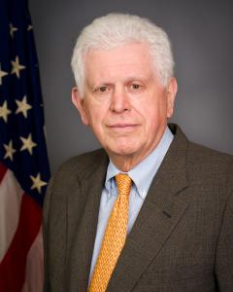

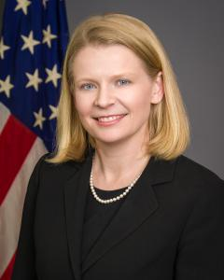
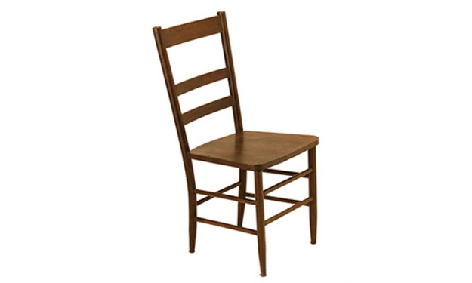
Current National Labor Relations Board
Chairman John F. Ring (R)
4/16/18 – 12/16/22
William Emanuel (R)
9/24/17 – 8/27/21
Marvin Kaplan (R)
8/10/17 – 8/27/20
Lauren McFerran (D)
12/17/14 – 12/16/19
Open Seat
8/27/18 – ???

Slide 4
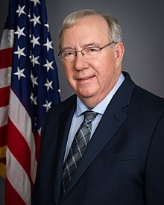
NLRB General Counsel – Case Handling Update
  Median age of all cases was reduced from 233 days in FY 2018 to 157 in FY 2019, a 33% drop.
  The Regional Office settlement rate was 99.1% in FY 2019, with more than 5,000 cases resolving prior to Board issuing complaint and over 800 cases resolving post-complaint.
General Counsel Peter Robb

Slide 5
Case Law Update

Slide 6
Unilateral Changes – MV Transportation, Inc.
The Board adopted the “contract coverage” standard, abandoning the “clean and unmistakable waiver” standard for considering whether an employer’s unilateral action is permitted by the parties’ collective bargaining agreement.
  Prior standard – Clear and Unmistakable Waiver – an employer’s unilateral change violated the act unless a contract provision unequivocally and specifically referred to the type of employer action at issue. Under this standard, the Union usually prevailed.
  New standard – Contact Coverage – if the employer’s action is within the “compass or scope” of contractual language granting the employer the right to act unilaterally, then no violation.
368 NLRB No. 66 (Sept. 10, 2019)

Slide 7
MV Transportation, Inc. (cont.)
Management Rights Provision:
Except to the extent expressly abridged by a provision of this Agreement, the Company reserves and retains, solely and exclusively, all of its rights to manage its business. Among those rights, and by no means a wholly inclusive list, is the right to determine staffing size, to decide and assign all schedules, work hours, work shifts, machines, tools, equipment and property to be used to increase efficiency; to hire, promote, assign, transfer, demote, discipline and discharge for just cause; and to adopt and enforce reasonable work rules.
The Company shall have the right to issue, amend and revise policies, rules and regulations and the issuance, amending or revision of such policies, rules and regulations shall not violate the terms of this Agreement. The Company will obtain input from the Union prior to implementation of policy, rules and regulations.

Slide 8
MV Transportation, Inc. (cont.)
The Board found that under the new Contract Coverage standard, the work rules the employer sought to implement – a “Light Duty Policy,” “Safety Policy,” “Schedule Adherence Policy,” “Security Sweep/Breach Policy,” and “DriveCam Policy” – all fell under the scope of the rights reserved by the language of the management rights clause.
Had the Board applied the former “clear and unmistakable waiver standard,” the management rights clause would not have allowed for the employer to unilaterally change these policies, as they were not expressly listed.
  The Board noted that this hypothetical result demonstrates why the former standard was “in practice, impossible to meet,” justifying the Board’s decision to abandon it.

Slide 9
Unilateral Changes – E.I. DuPont de Nemours
ULP charge alleging that the employer made unilateral changes to company-wide Dental Assistance Program and Medical Care Assistance Program retirement benefit plans. Each plan contained a “reservation of rights” provision stating that the employer retained the right to modify/terminate the plans at its discretion, something the employer had done on multiple occasion over previous years.
CBA contained the following : “All existing privileges heretofore enjoyed by the employees in accordance with the following Industrial Relations Plans and Practices of the Company shall continue, subject to the provisions of such Plans.”
This language, together with the parties’ past practice, show a waiver of the Union of any obligation by the employer to bargain over changes to the benefit plans.
368 NLRB No. 48 (Sept. 4, 2019)

Slide 10
Weingarten Rights – Pacific Architects & Engineers
Facts: During investigation by the employer into employee misconduct, the employee requested the union attorney act as his union representative. The employer denied this request and provided a list of “acceptable” union representatives.
  During the investigative meeting, the investigator did not permit the union representatives to ask any questions, and instructed the employee to prepare a written statement before consulting with the union representatives.
  The investigator then conducted a “question-and-answer” session, where the investigator read written question to the employee, the employee wrote down answers, and the investigator then read the answers aloud.
  The Union representatives were not allowed to ask questions until after the employee submitted his answers.
367 NLRB No. 105 (Mar. 8, 2019)

Slide 11
Pacific Architects & Engineers (cont.)
The Board found that the refusal to allow the union attorney to attend the investigation was a violation of the employee’s Weingarten rights.
  The ALJ below noted that Weingarten provides a right to a representative that is an agent of the labor organization (which the attorney was), and provides the right to choose the specific available union representative.
  The Board found that the employer’s conduct during the meeting, forcing the employee to respond in writing before letting the union representative ask questions, to be appropriate, noting that: “employer [] is free to insist that he is only interested [] in hearing the employee’s own account of the matter under investigation.”

Slide 12
Protected/Concerted Activity – Alstate Maintenance
Facts: An employee in 2013 working as a “skycap” at JFK refused to perform his job duties of assisting customers with their luggage outside the entrance to the airport. Specifically, when instructed by a supervisor to assist with an arriving professional soccer team’s equipment, stated that he wouldn’t help because “we did a similar job a year prior and we didn’t receive a tip for it.”
The employee made this statement in front of his co-workers. When the team arrived, the employees refused to assist with the team’s bags and walked away, causing the supervisor to seek assistance from baggage handlers insider the terminal, causing considerable embarrassment to the company.
The complaining employee, and three coworkers, were fired.
367 NLRB No. 68 (Jan. 11, 2019)

Slide 13
Alstate Maintenance (cont.)
Section 7 of the NLRA provides employees with the right to engage in “concerted activities for the purpose of . . . mutual aid or protection.”
In order to be protected, the conduct must meet two elements:
The action must be concerted, i.e. undertaken for the benefit of a group.
The action must be undertaken for the purpose of mutual aid or protection, typically meaning an effort to improve bargaining unit employees’ terms and conditions of employment.

Slide 14
Alstate Maintenance – (cont.)
Board: to be concerted, “an individual employee’s statement to a supervisor or manager must either bring a truly group complaint regarding a workplace issue to management’s attention, or the totality of the circumstances must support a reasonable inference that in making the statement, the employee was seeking to initiate, induce or prepare for group action.”
Applying this standard, the employee had not engaged in concerted activity and, even if he had, he did not make his remark about the soccer team’s tipping for the purpose of mutual aid or protection of the collective group of employees. The Board expressly rejected the general counsel’s argument that the employee’s use of the plural pronoun “we” made his complaint protected activity.
Overruled 2011 case of Worldmark by Wyndham, where the Board held that if an employee protests publically in a group meeting, then they are, as a matter of law, “engaged in initiating group action,” and therefore the conduct was protected.

Slide 15
Work Rules – LA Specialty Produce Company
The Board clarified the two-part Boeing balancing test used to evaluate whether a workplace rule violates/constricts employees exercising their Section 7 rights.
The Board reiterated that a facially neutral work rule will be found unlawful if:
  The rule would (as opposed to could) potentially interfere with the exercise of NLRA rights.
  The potential adverse impact on the employees’ rights outweighs the employer proffered justification for the workplace rule.
368 NLRB No. 93 (Oct. 10, 2019)

Slide 16
LA Specialty Produce Company – cont.
Two work rules were at issue in LA Specialty Produce:
“Employees approached for interview and/or comments by the news media, cannot provide them with any information. Our President, Michael Glick, is the only person authorized and designated to comment on Company polices or any event that may affect our organization.”
  Found to be lawful, as nothing in the Act provides an employee to speak on behalf of their employer, and a reasonable employee would understand that they would be able to speak with the media on their own behalf.
Every employee is responsible for protecting any and all information that is used, acquired or added to regarding matters that are confidential and proprietary of [employer] including but not limited to client/vendor lists . . . .
  Found to be lawful, on the basis that an objectively reasonable employee would not interpret this rule to prohibit or interfere with the exercise of Section 7 Rights.

Slide 17
Work Rules – Facebook Videos/Defamation
In an advice memorandum released in April 2019, the NLRB’s Division of Advice analyzed the legality of the following policy language:
Employees must refrain from engaging in conduct that could adversely affect the Company’s business or reputation. Such conduct includes, but is not limited to…publicly criticizing the Company, its management or its employees.
The employer had disciplined two employees for posting videos on Facebook critical of the company.
Additionally, the employer’s standard disciplinary letter language prohibited the employees from discussing discipline with their coworkers or company clients.
Colorado Professional Security Services, LLC (Case 27-CA-203915)

Slide 18
Work Rules (cont.)
The Division of Advice concluded that both the policy prohibiting employees from criticizing the company and the discipline language that prohibited employees from discussing their discipline with coworkers or clients violated the NLRA. Specifically, the Division of Advice found:
The rule prohibiting any public criticism of the company or management expressly interfered with any appeals by employees to the public in labor disputes (which is unlawful) and there was no legitimate business justification for a total ban.
The disciplinary letter language expressly interfered with employees’ right to communicate with each other and third parties regarding the terms and conditions or employment, again without any legitimate business justification to do so.

Slide 19
Property Rights - UPMC Presbyterian Hospital
In UPMC, the Board expanded the ability of employers to eject nonemployee union organizers from publicly accessible spaces on their premises.
Under the U.S. Supreme Court’s Babcock standard, employers may prohibit organizing activity by nonemployees if:
  Reasonable efforts by the union through other channels would allow it to reach the employees (known as the “inaccessibility” exception) and
  If the employer does not discriminate against the union by allowing other distribution (known as the “discrimination” exception).
The Board adopted a “public space” exception: an employer violated Section 8(a)(1) by denying access to cafeterias and restaurants open to the public if the organizers used the facility in a manner consistent with its intended use in a non-disruptive manner.
368 NLRB No. 2 (Oct. 14, 2019)

Slide 20
Property Rights (cont.)
“Public Space” exception abolished:
In UPMC, the Board expressly found that “to the extent that Board law created a ‘public space’ exception that requires employers to permit nonemployees to engage in promotional or organizational activity in public cafeterias or restaurants absent evidence of inaccessibility or activity-based discrimination, we overrule those decisions.”
The Board additionally held that the focus should be on the type of conduct engaged in by the Union organizers in relation to the activity engaged in. Therefore, simply because the employer had allowed some organizations to come on-site did not automatically entitle the union to access.

Slide 21
Property Rights – Bexar Cnty. Performing Arts Center
The Board analyzed whether a property owner violated Section 8(a)(1) by barring off-duty employees of an on-site contractor from leafletting on its property.
Held: A contractor’s employees are generally not entitled to the same Section 7 access rights as a property owner’s own employees, adopting the following standard: A property owner may exclude from its property the off-duty employees of an on-site contractor, unless:
The employees in question work both regularly and exclusively on the property; and
The property owner fails to show that the employees have one ore more reasonable alternative means to communicate their message (i.e. use of adjacent property, newspapers, radio, television, billboards, and/or social media).
368 NLRB No. 46 (Aug. 10, 2019)

Slide 22


Property Rights – Kroger Limited Partnership
Held: A business may lawfully limit the rights of non-employee union supporters to access company property, based on the type of activity the supporters are engaging in.
While an employer may still not discriminate against a union in denying access, the Board clarified that the relevant inquiry is whether the employee has allowed similarly natured activities in the past.
Stated differently, an employer may deny access to non-employees seeking to engage in protest activities on its property while allowing non-employee access for a wide range of charitable, civic, and commercial activities that are not similar in nature to protest activities.
368 NLRB No. 64 (Sept. 6, 2019)

Slide 23
Intermittent Strikes – Walmart Stores, Inc.
In 2010, a group of Walmart workers banded together to form an organization called OUR Walmart. This group was not officially union-represented, but received assistance from the United Food and Commercial Workers Union.
On four occasions between October 2012 and November 2013, members of OUR Walmart went on strikes, of durations between one and six days. In late May/June 2013, the third strike of the campaign involved more than 100 employees leaving work to protest at the annual shareholder meeting, a work stoppage that lasted five to six days. 54 participating employees were disciplined or discharged for violating Walmart’s attendance policy.
Issue: Was this an intermittent strike, and therefore not protected activity under the National Labor Relations Act?
Intermittent strikes are unprotected because they create instability at an employer’s workplace due to their disruptive nature. An intermittent strike is “a plan to strike, return to work, and strike again.” Farley Candy Co., 300 NLRB 849 (1990).
368 NLRB No. 24 (July 25, 2019)

Slide 24
Walmart Stores, Inc. (cont.)
The ALJ found that the strike at issue was not an intermittent strike because it was five to six days in duration, and was not scheduled close in time to the group’s other short duration strikes (it came 7 months after the prior work stoppage).
The Board reversed, holding that the judge failed to recognize the ultimate and essential inquiry on this subject: “whether the work stoppage was pursuant to a strategy to use a series of strikes in support of the same goal.”
The Board found that the work stoppage was in support of the same goal (placing pressure on Walmart) and was therefore unprotected.

Slide 25
Walmart Stores, Inc. (cont.)
Because the Union stipulated that the strike was pursuant to a strategy to use a series of strikes to support the same goal, the Board did not need to analyze the following factors:
  Whether employees have engaged in a pattern of recurring work stoppages and/or demonstrated an intent to engage in a future pattern of recurring work stoppages;
  Whether the work stoppages occurred over a short period of time and were short in duration;
  Whether the stoppages were part of a common plan aimed at addressing the same goal or dispute;
  Whether the stoppages arose from a union strategy to exert additional economic pressure on an employer;
  Whether the stoppages were part of a scheme to harass the employer into a state of confusion and chaos; and
  Whether the work stoppages arose from a union strategy to exert additional economic pressure on the employer during collective bargaining negotiations.
368 NLRB No. 24 (July 25, 2019)

Slide 26
Mandatory Arbitration – Supreme Court - Epic
In three decisions, the NLRB clarified the impact of the Supreme Court’s recent decision regarding mandatory arbitration agreements in Epic Systems v. Lewis, 138 S. Ct. 1612 (May 21, 2018).
In the May 2018 decision of Epic Systems, the United States Supreme Court held that:
The Federal Arbitration Act (“FAA”) mandates the enforcement of arbitration agreements; and
The right to pursue a class of collective relief is not a protected concerted activity under Section 7 of the NLRA.

Slide 27
Mandatory Arbitration – Cordua Restaurants, Inc.
In Cordua Resturants Inc., the Board clarified the following regarding mandatory arbitration agreements following Epic Systems:
  Employers are not prohibited under the NLRA from informing employees that failing or refusing to sign a mandatory arbitration agreement will result in their discharge.
  Employers are not prohibited under the NLRA from promulgating mandatory arbitration agreements in response to employees opting in to a collective action under the Fair Labor Standards Act or state wage-and-hour laws.
  Employers are prohibited from taking adverse action against employees for engaging in concerted activity by filing a class or collective action, consistent with the Board’s long-standing precedent.
368 NLRB No. 43 (Aug. 14, 2019)

Slide 28
Mandatory Arbitration – Prime Healthcare Paradise
Clarifies that if an arbitration agreement either explicitly, or reasonably implies, that employees are prohibited from filing a charge with the NLRB, the agreement violates the NLRA.
Language found to be unlawful in Prime Healthcare:
Except as otherwise provided in this Agreement, the Company and the Employee hereby consent to the resolution by binding arbitration of all claims or controversies for which a federal or state court would be authorized to grant relief, whether or not arising out of, relating to or associated with the Employee’s employment with the Company.
Claims covered by this Agreement include, but are not limited to, claims for wages or other compensation due; claims for breach of any contract or covenant, express or implied; tort claims; claims for discrimination or harassment . . . And claims for violation of any federal, state or other governmental constitution, statute, ordinance, regulation, or public policy. . .
368 NLRB No. 10 (June 18, 2019)

Slide 29
Mandatory Arbitration – Beena Beauty Holding, Inc.
Similarly, in Beena Beauty, the NLRB found that mandatory arbitration language violated the NLRA. The policy did not mention the NLRA or the right to file charges before the Board, but broadly stated that the arbitration provision applied generally to all employment claims, and only expressly excluded unemployment and worker’s compensation claims:
“The company and [employees] agree . . . To submit any claims that either has against the other to final and binding arbitration.”
Held: The arbitration provision did unlawfully interfere with employees‘ Section 7 rights, because a reasonable employee might construe it as restricting access to the Board‘s unfair labor practice charge procedures.
368 NLRB No. 91 (Oct. 8, 2019)

Slide 30
Micro Units – The Boeing Company
In Boeing, the International Association of Machinists won a May 2018 election to become the bargaining representative of a small unit of employees at a South Carolina Boeing plant. The vote was limited to employees in only two job classifications within an aircraft production line.
This election came after an earlier election in which a large unit of production and maintenance workers rejected the Union in a 2,087 -731 vote.
After the May 2018 election, Boeing appealed the certification of the smaller unit of about 175 employees, claiming that the NLRB Regional Director had improperly approved the small unit of flight-readiness technicians.
The Board determined that employees in the proposed unit did not share an “internal community of interest” and did not have “sufficiently distinct interests” from other employees who were excluded from the petitioned-for unit.
368 NLRB No. 67 (Sept. 9, 2019)

Slide 31
Micro Units (Con’t)
This case clarified the Board’s standard for reviewing whether a small bargaining unit within a larger workforce, often referred to as a “micro unit,” is an appropriate unit under the NLRA.
When determining whether a unit is an appropriate unit, the Board will consider the following factors:
  Whether the employees of the petitioned-for/proposed unit share a community of interest with each other;
  Whether the employees excluded from the unit have meaningfully distinct interests in the context of collective bargaining that outweigh similarities with those of the petitioned-for/proposed unit; and
  Whether the petitioned-for/proposed unit meets the guidelines, if any, the Board has established for units in specific industries.
368 NLRB No. 67 (Sept. 9, 2019)

Slide 32
Independent Contractors – Super Shuttle
The NLRB confirmed that it will follow the common-law test for determining independent contractor status, including looking at the following, non-exclusive factors:
The extent of control the employer exercises over the work;
Whether or not the individual is engaged in a distinct occupation or business;
The kind of occupation, with reference to whether, in the locality, the work is usually done under the direction of the employer or by a specialist without supervisor;
The skill required;
Which party supplies the tools to perform the work;
The length of time for which the person is employed;
The method of payment, whether by time or by job;
Whether the work is part of the regular business of the employer;
Whether the parties believe they are creating the relation of master and servant; and
Whether the principal is or is not in business.
367 NLRB No. 75 (Jan. 25, 2019)

Slide 33
Independent Contractors – Velox Express
Misclassifying an employee as an independent contractor does not, in and of itself, violate the NLRA.
More specifically, the Board found that an employer’s communication to its workers of its opinion that they are independent contractors does not, standing alone, violate the NLRA if the opinion turns out to be incorrect, on the basis that such a communication does not inherently threaten the employees, nor communicate that it would be futile to engage in any protected concerted activities.
While this ruling is significant for employers, it remains important to note that an employer still cannot intentionally misclassify workers as independent contractors in an attempt to circumvent the workers from receiving the protection of the Act.
368 NLRB No. 61 (Aug. 29, 2019)

Slide 34
Successorship – Ridgewood Health Center
The Board overruled two decades of precedent regarding successor employer bargaining obligations.
Under certain circumstances, a firm purchasing a business with an existing unionized workforce may have an obligation to bargain with the incumbent union before setting the employees terms and conditions of employment, specifically if the buyer is a “perfectly clear successor.”
A buyer is a perfectly clear successor if the incumbent employees reasonably believe that the buyer will retain “all” or “substantially all” of a predecessor’s unit employees without changing those employees’ terms and conditions of employment.
If a buyer is not a perfectly clear successor, then the buyer is able to set the employees’ initial terms and conditions of employment as it sees fit. However, the buyer may still have an obligation to recognize the incumbent union if two factors are met: (1) if the buyer runs the operation in the same manner as the seller had, and 2) if the buyer hires enough of the seller’s employees to comprise a majority of the employees in the new unit.
367 NLRB No. 110 (April 2, 2019)

Slide 35
Successorship (Cont.)
One caveat to the successorship analysis was created in the 1996 decision of Galloway School Lines, wherein the Board held that if a buyer discriminates in hiring any of a predecessor’s represented workers in an effort to avoid a resulting majority in the new workforce, then the buyer waives its right to set the initial terms and conditions of employment for its employees and remains bound by the existing collective bargaining agreement (CBA), effectively becoming a perfectly clear successor.
In Ridgewood, the Board overruled Galloway and removed this exception by lessening the available remedy.
Specifically, the Board in Ridgewood found that the employer had discriminated against hiring four workers as a result of their union membership. Rather than finding the employer was thereby a perfectly clear successor, the employer was ordered to hire the discriminated against workers. This gave the union majority status, obligating the employer to recognize and negotiate with the Union.

Slide 36

Looking Ahead

Slide 37
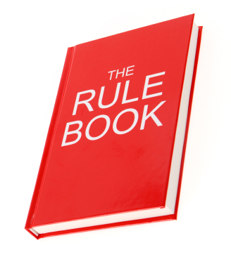
NLRB Rulemaking Push
The NLRB has, in recent years, pushed to use formal rulemaking to enact changes to/shape labor law.
Traditionally, the Board has acted through decisions in individual cases, rarely using rulemaking to establish rules.
By enacting change through rulemaking, as opposed to through traditional cases, these changes will theoretically be harder to repeal should a Democrat become President in 2020.

Slide 38
NLRB Federal Rulemaking Process
NLRB Publishes a Proposed Rule
NLRB Invites the Public to Comment on the Proposed Rule
NLRB Reviews the Public Comments
Final Rule is Published and Implemented

Slide 39
Proposed Rule – Election Procedures
On August 12, 2019, the NLRB published a Notice of Proposed Rulemaking (“NPRM”) seeking to make changes to multiple election procedures. Specifically, the proposed rule makes the following changes:
Change to Blocking Charge Policy: The NPRM proposes replacing the current blocking charge policy with a vote-and-impound procedure. Elections would no longer be blocked by pending unfair labor practice charges, but the ballots would be impounded until the charges are resolved.
Change to Voluntary Recognition Bar: The NPRM proposes returning to the rule of Dana Corp., 351 NLRB 434 (2007). For voluntary recognition under Section 9(a) of the Act to bar a subsequent representation petition—and for a post-recognition collective-bargaining agreement to have contract-bar effect—unit employees must receive notice that voluntary recognition has been granted and a 45-day open period within which to file an election petition.

Slide 40
Invitation for Briefs – Profane Statements
On September 5, 2019, the Board issued a notice inviting interested parties to file briefs regarding the question of under what circumstances an employee’s profane, offensive, and/or racially charged statements lose the protection of the Act. Specifically, the Board sought input regarding the following topics:
Under what circumstances should profane language or sexually or racially offensive speech lose the protection of the Act?
How much leeway should employees engaged in Section 7 activity be granted?
Should the Board consider the norms of the workplace in its analysis, particularly whether profanity is commonplace and tolerated?
Should the Board overrule its prior decisions in which the fact that the language in question occurred on a picket line was a relevant determination?
What relevance should the Board accord to antidiscrimination laws such as Title VII in determining whether a statement loses the protection of the Act?
Inviting these brief could be interpreted as a signal that the Board intends to change this standard.

Slide 41
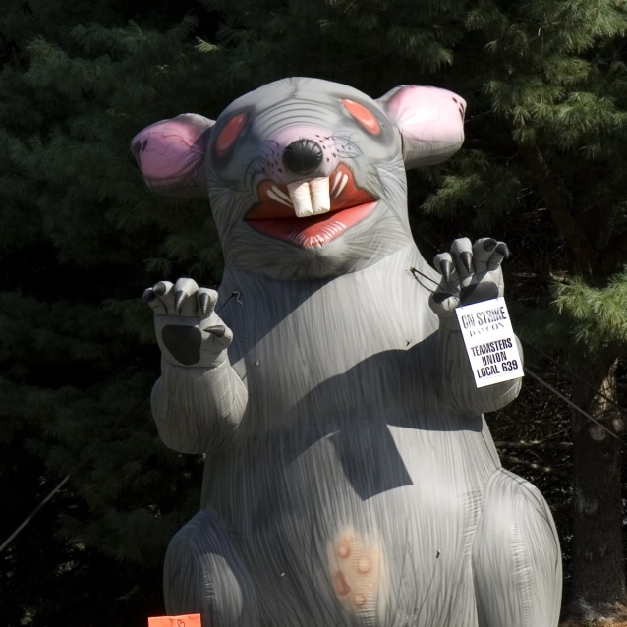
Potential Change – Scabby the Rat
On May 17, 2019, the NLRB’s Division of Advice recommended that the Board find that certain union conduct, including the use of stationary banners and an inflatable rat at neutral employers’ facilities, was lawful activity under the Act. Essentially, the Division of Advice wishes the Board to find that the use of inflatable displays, including “Scabby the Rat” and “Corporate Fat Cat,” to constitute impermissible “threats, coercion, or restraint.”
In a case currently pending before the Board regarding the use of Scabby, the GC filed a brief making the following arguments in favor of finding an unfair labor practice:
“A huge, menacing inflatable rat placed near a business entrance thus inherently conveys a threatening and coercive message that will restrain a person. . . ” “For three days, pedestrians, guests, employees and contractors…could not avoid large, intimidating, hostile-looking inflatable rats that were mere feet, and sometimes inches, away from them.”
A federal judge denied the GC’s petition for a temporary restraining order against a union using Scabby inflatables on June 19, 2019.
Scabby

Slide 42
THANK YOU.
Questions?

