Slide 1
Felhaber Larson Labor & Employment Law Seminar 2018
Table of Contents
Topic Page
Personnel Policies under the New NLRB 2
Walk Me Through Grievance Processing 51
Walk Me Through Non-Competes 89
Labor & Employment Update 114
Pay Equity 207
Walk Me Through Return to Work 252
Sexual Harassment in the #MeToo Era 290
Walk Me Through Terminations 342

Slide 2
2018 Labor and Employment Seminar
Paul J. Zech
Felhaber Larson
220 South 6th Street, Suite 2200
Minneapolis, MN 55402

Slide 3
Personnel Policies
Under the New NLRB

Slide 4
Summary
New NLRB rules on handbooks
Focus on specific policies
Social media
Workplace behavior and civility
Confidentiality
Other specific developments
Joint Employer
Picketing
Union organizing and solicitation

Slide 5
What is the NLRA/NLRB?
NLRA impacts union and non-union workplaces
“other concerted activities for the purpose of . . . mutual aid or protection.”
NLRB oversees and enforces labor law.
Both protect and govern union and non-union workplaces.

Slide 6
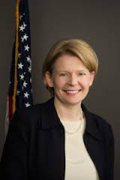
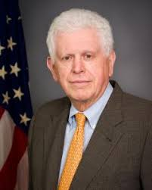
Board Composition
Lauren McFerran (D)
Member
Term Expiration – December 16, 2019
Marvin Kaplan (R)
Member
Term Expiration – August 27, 2020
William Emanuel (R)
Member
Term Expiration – August 27, 2021
John Ring (R)
Chair
Term Expiration December 16, 2022
Peter Robb (R)
General Counsel
Confirmed November 8, 2017
4-year term

Slide 7
Employee Handbooks
Handbook Interpretation (GC 18-04)
Ambiguities in handbook rules are no longer interpreted against the drafter.
General provisions interpreted narrowly, not as banning all activity that “could conceivably be” included.

Slide 8
Employee Handbooks
Handbook Interpretation (GC 18-04)
A neutral rule does not render protected activity unprotected.
Application of facially neutral rule against employees engaged in protected activity remains unlawful.

Slide 9
Employee Handbooks
Takeaway:
Current NLRB will not scrutinize handbook and personnel policies as closely as the Obama-era Board.

Slide 10
Employee Handbook Rules
Background:
The Boeing Company, 365 NLRB No. 154 (Dec. 14, 2017) created new test for interpreting lawfulness of policy.

Slide 11
Employee Handbook Rules
Previous test: a workplace policy was unlawful if an employee “would reasonably construe” the rule to restrict protected concerted activity.
New Boeing test: balance two factors to determine legality:
The rule’s potential impact on protected concerted activity; and
The employer’s legitimate business justification(s) for the rule.

Slide 12
Employee Handbook Rules
GC Memo 18-04
Provided clarity regarding NLRB’s view on many handbook provisions
Created three categories of rules:
Category 1: generally lawful rules
Category 2: case-by-case scrutiny of rule
Category 3: generally unlawful rules

Slide 13
Employee Handbook Rules
Category 1 Rules
9 “generally lawful” policies
Civility: Can prohibit disparagement of other employees.
No Photography/Audio/Video Recording: Can prohibit employees from using camera or recording device at work (does not mean employers can ban all phone use/possession).

Slide 14
Employee Handbook Rules
Category 1 Rules
Insubordination: Can prohibit employee insubordination or improper conduct that adversely affect operations.
Disruptive Behavior: Can ban conduct causing disruptions during work hours (not including strikes or walkouts).

Slide 15
Employee Handbook Rules
Category 1 Rules
Protecting Confidentiality: Can prohibit disclosure of proprietary, confidential, and customer information.
Defamation or Misrepresentation: Can prohibit communications that are defamatory or that misrepresent company products, services, or employees.

Slide 16
Employee Handbook Rules
Category 1 Rules
Use of Employer Logos: Can ban employee use of company logo for non-business purposes.
Employer Authorization to Speak for Company: Can ban employees from speaking for company in person or on social media.
Disloyalty, Nepotism, or Self-enrichment: Can prohibit employees from competing with, exploiting position with, or interfering with company.

Slide 17
Employee Handbook Rules
Category 2 Rules
These rules are evaluated on case by case basis – “individualized scrutiny”
Balance employee v. employer interests

Slide 18
Employee Handbook Rules
Category 2 Rules
Examples:
Broad Conflict-Of-Interest Rules: Where the rules do not specifically target fraud and self-enrichment, they will be scrutinized.
Confidentiality Rules: Broad rules encompassing “employer business” or all “employee information” may infringe on protected Section 7 rights.
Anti-Disparagement Rules: Rules regarding disparagement or criticism of the employer should be scrutinized (unlike criticism of employees).

Slide 19
Employee Handbook Rules
Category 2 Rules
Rules Regulating Use of the Employer’s Name: these rules will be highly scrutinized (unlike using company’s logo, which may be protected).
Rules Prohibiting Speaking to the Media: Will be scrutinized (unlike speaking on employer’s behalf, which can be banned).

Slide 20
Employee Handbook Rules
Category 2 Rules
Off-Duty Conduct Rules: Will depend on which conduct is being regulated.
Rules Generally Prohibiting False Statements: Will be highly scrutinized (unlike rules against defamatory statements, which are lawful).

Slide 21
Employee Handbook Rules
Category 3 Rules
Presumptively Unlawful
Examples:
Cannot prohibit disclosure of wage, salary, benefit, working conditions.
Cannot prohibit joining outside organizations (i.e. unions).

Slide 22
Employee Handbook Rules
Takeaways
These interpretations and rule changes represent a dramatic change.
Several of these now-lawful rules were expressly banned under previous Board interpretations.
Examples: Photo/video recording at work; use of employer logo; confidentiality.

Slide 23
Focus on Specific Policies
Social Media -- NLRB Position:
Federal law give all employees the right to join together online.
Using social media can be a form of “protected concerted” activity.
Employees have right to address work-related issues and share information about pay, benefits, and working conditions with coworkers online.

Slide 24
Focus on Specific Policies
Social Media -- NLRB Position:
But, individually griping about some aspect of work is not “concerted activity”
To be protected, social media activity must have some relation to group action, or seek to initiate, induce, or prepare for group action, or bring a group complaint to the attention of management.

Slide 25
Focus on Specific Policies
Social Media
North West Rural Electric Coop., 366 NLRB No. 132 (July 19, 2018).
Employee fired for posting on Facebook group comments critical of employer’s safety practices.
Employer cited “conduct” and “attitude” policies as rationale.
NLRB sided with employee, holding that neutral policies cannot be applied to suppress worker rights.

Slide 26
Focus on Specific Policies
Workplace Behavior and Civility
Mexican Radio Corp., 366 NLRB No. 65 (2018):
Employee quit by sending profane, “opprobrious” email to coworkers, management, and owners about employer’s management style and business practices.
Four employees responded to group email in agreement to the complaints.
These four employees were each interviewed and terminated for violating company insubordination and behavior policies.

Slide 27
Focus on Specific Policies
Workplace Behavior and Civility
Mexican Radio Corp., 366 NLRB No. 65 (2018):
NLRB:
Employees engaged in protected activity by responding to the emails
Emails were private and did not harm company reputation or cause disruption.
Employer unlawfully applied neutral workplace policy to terminate employees.

Slide 28
Focus on Specific Policies
Workplace Behavior and Civility
Examples of lawful civility policies:
“Conduct that is inappropriate or detrimental to patient care or hospital operation, or that impedes harmonious interactions and relationships, will not be tolerated.”
“Behavior that is rude, condescending, or otherwise socially unacceptable is prohibited.”
“Disparaging the company’s employees is prohibited.”

Slide 29
Focus on Specific Policies
Confidentiality
Dura-Line Corp., 366 NLRB No. 126 (2018)
Employer forced to close plant and relocate. Sought to transfer several employees to new location.
Employer presented non-disclosure agreement (NDA) to selected employees, which prohibited sharing of “confidential information” with third parties.
Confidential information included relocation plans, wages, or job at new plans.

Slide 30
Focus on Specific Policies
Confidentiality
Dura-Line Corp., 366 NLRB No. 126 (2018)
Employee challenged NDA as intended to prevent union activity.
NLRB upheld NDA.
Held that employer had legitimate concerns about controlling timing and disclosure of relocation news.

Slide 31
Focus on Specific Policies
Confidentiality
Examples of lawful confidentiality policies:
“Information concerning customers shall not be disclosed, directly or indirectly, or used in any way.”
“Do not disclose confidential financial data, or other non-public proprietary company information. Do not share confidential information regarding business partners, vendor, or customers.”

Slide 32
Focus on Specific Policies
BUT, confidentiality has its limits.
Costco Wholesale Corp., No. 366 NLRB No. 9 (2018):
After workplace altercation, Costco conducted employee interviews.
Costco told employee not to “have any conversations with anyone else pertaining to this incident.”
NLRB: Employer must demonstrate its need for confidentiality outweighs harm to employee’s rights.
Costco did not explain need, so violated NLRA.

Slide 33
Focus on Specific Policies
BUT, confidentiality has its limits.
Colorado Symphony Ass’n, 366 NLRB No. 122 (2018):
Employer insisted that union sign a confidentiality agreement that included a monetary damages clause.
Union objected to monetary damages clause.
NLRB:
Damage clause unlawful because employer had no basis for believing union would violate agreement.
Therefore, not reasonable to dispel confidentiality concerns.

Slide 34
Other Significant Developments
Joint Employer
New rule proposed September 2018
“An employer may be considered a joint employer of a separate employer’s employees only if the two employers share or codetermine the employees’ essential terms and conditions of employment, such as hiring, firing, discipline, supervision, and direction.
A putative joint employer must possess and actually exercise substantial direct and immediate control over the employees’ essential terms and conditions of employment in a manner that is not limited and routine.”

Slide 35
Other Significant Developments
Joint Employer
Proposed rule intended to “foster predictability, consistency and stability.”
Rule is very rigid.
Even “direct and immediate” control may not satisfy standard if the control is limited in scope and does not include “essential terms.”
Rule currently in comment period.

Slide 36
Other Significant Developments
Picketing
Ortiz Janitorial Services, 366 NLRB No. 159 (2018):
Janitors employed by subcontractor to provide cleaning services for company. They picketed at company’s building, which was managed by third-party.
Janitors sought increased wages and remediation of harassment.
NLRB held the protests were “secondary activities” not protected by NLRA.

Slide 37
Other Significant Developments
Picketing
Ortiz Janitorial Services, 366 NLRB No. 159 (2018):
Board found that object of protests was the building manager, not just employer.
Goal was to disrupt business relationship between them.
Takeaway: NLRB taking close look at “secondary picketing” and picketing sites where multiple companies share office space.

Slide 38
Other Significant Developments
Picketing
Capital Medical Ctr., 2018 U.S. App. LEXIS 22395 (D.C. Cir. Aug, 10, 2018):
Off-duty hospital employees picketing at non-emergency hospital entrance.
No chanting, marching, or obstruction.
NLRB held, and DC Circuit affirmed, that picketing was lawful because hospital could not show that removal of picketers was necessary to prevent patient disturbance.

Slide 39
Other Significant Developments
Picketing
NLRB GC Memo 18-02 in December 2017.
Signaled intent to revisit off-duty picketing issue.
May expand employer rights to control picketing on property, particularly where employer has legitimate safety interest (i.e. hospital’s interest in patient care).

Slide 40
Other Significant Developments
Union organizing and member solicitation
UPMC, 366 NLRB No. 142 (2018):
Employer’s solicitation and distribution policy prohibited off-duty employees from soliciting or being solicited in non-work areas during non-work time.
NLRB struck down policy because it banned union activity without being necessary to avoid disruption of healthcare operations.

Slide 41
Other Significant Developments
Union organizing and member solicitation
Seven Seas Union Square, LLC, 2018 NLRB LEXIS 79 (2018):
ALJ decision. Employee challenged employer’s rules prohibiting workplace solicitation, loitering, and political activities.
ALJ:
Non-solicitation rule is a category-3 practice and unlawful.
No-politics rule is a category-2 rule and unlawful, since “’politics’ certainly incorporates . . . protected activity.”
Loitering rule is a category-2 rule and lawful.

Slide 42
Other Significant Developments
Repudiating Unlawful Policy
TBC Corp., 367 NLRB No. 18 (2018):
Employer issued a handbook policy that banned solicitation on company property during non-work hours.
Policy was unlawfully overbroad, and employer voluntarily changed policy by distributing and posting a notice to employees at all stores of the repudiated policy.
ALJ found employer’s repudiation ineffective because it did not explain the reasons for changing the policy.

Slide 43
Other Significant Developments
Repudiating Unlawful Policy
TBC Corp., 367 NLRB No. 18 (2018):
NLRB reversed, holding there was no violation.
NLRB explained:
Employer’s are not required to explain why they are repudiating an unlawful policy. It is sufficient for employers to amend the handbook and notify the affected employees of the new rules.
Takeaway: Company can save time and money by clearly following NLRB notice procedures for repudiating unlawful policy.

Slide 44
Forecasted Changes
Workplace computer use for personal purpose
NLRB issued notice and invitation to file briefs in Caesars Entertainment Corp.
Case seeks to overrule Purple Communications, Inc. standard governing whether and how employers can prohibit use of its computer resources (i.e. emails) to send non-business information.
A finding for Caesars would allow employers to impose Section 7-neutral restrictions.

Slide 45
Forecasted Changes
GC recently released four Obama-era GC advice memos.
May signal current Board’s plan to address these issues.
Issues include employer’s ability to:
direct worker to take off union t-shirt;
prohibit night-shift workers form wearing union insignia;
permanently replace striking workers;
take photos of union solidarity marches
Also includes difference between legal on-site work stoppage and illegal sit down strike.

Slide 46
Summary
New NLRB is taking employer-friendly stances on many workplace issues.
This may change the way that employers create and enforce workplace personnel policies.
Specifically, employers have more leeway in crafting policies that ban “category 1” activities.

Slide 47
Summary
However:
Employers must closely tailor the policies to workplace needs.
Overbroad policies may be deemed unlawful.
Employers must neutrally enforce the policies to avoid violating employee rights.
Social media activities still closely monitored and may be deemed protected activity depending on the content and platform.

Slide 48
Summary
Follow NLRB decisions to see how Board interprets and applies the personnel policy rules discussed in the GC Memos.
Forecasted changes coming for:
Joint employer rule
Workplace computers for personal purpose
Workplace clothing and insignia
Camera and photo use
Picketing

Slide 49
Practice Tips
Review current personnel policies to identify rules that could be strengthened to protect legitimate employer interests.
Rewrite policies that run the risk of being overbroad. Tailor each rule to interests that NLRB has deemed valid. Consider including examples of prohibited behavior to avoid risk of overbreadth.
Ensure no rules prohibit arguably protected activity under the NLRA. This includes rules on private off-duty email, social media use, and conduct.
Train management, supervisors, and human resources on how to deal with employee disputes. This will safeguard a company from the risk that policies are applied unequally and deemed invalid.

Slide 50
Practice Tips
5. Outline clear procedures for reporting workplace violations. Work with different levels of company to ensure that reporting mechanisms will be utilized and effective.
6. Include conspicuous disclaimers in the handbook. This may include disclaimers that the handbook is not a contract, contains no guarantees, and may be amended by the employer at any time without company. This may require union approval.

Slide 51
WALK ME THROUGH GRIEVANCE PROCESSING
-----------------------------------------------------------------
Tom Trachsel & Meggen Lindsay
November 2, 2018

Slide 52
What is a grievance?
In general, a grievance is a formal claim by the Union that the Employer has, in some manner, violated or breached the union contract a/k/a the collective bargaining agreement.
Most collective bargaining agreements contain a definition for a “grievance.” Sometimes a contractual provision will specifically state that a dispute over that provision is subject to the grievance procedure.

Slide 53
Grievance ≠ Charge
A grievance must be distinguished from-
Unfair labor practice (ULP) charge
A grievance is a claim that the Employer breached the contract; it is submitted to, or filed with, the Employer.
A ULP charge is a claim that the Employer violated the National Labor Relations Act (NLRA) (i.e., committed an unfair labor practice or ULP). A charge is filed with, and investigated by, the National Labor Relations Board (NLRB).
Notes:
Sometimes the Union files a grievance and a charge.
Discrimination / retaliation against union steward.
Unilateral changes – Change in cafeteria discount at Methodist.

Slide 54
Two types of grievances
Contract interpretation. The Union claims that the Employer has not followed a requirement of the contract, or has improperly made a change of some sort.
The burden is on the Union to establish a breach of the contract. At an arbitration hearing, the Union presents its case first.
Discipline. The Union claims that the Employer disciplined or terminated an employee without just cause.
The burden is on the Employer to establish that it had just cause to discipline or terminate the employee. At an arbitration hearing, the Employer presents its case first.

Slide 55
Causes of contract interpretation grievances
The Employer actually did not follow the contract.
The contract is silent on the issue.
This situation is often the source of union claims of “past practice.”
There is language in the contract on the general issue, but the language does not answer the specific question one way or the other.
The Union must “take a stand” because the issue is important to the Union, or because the Union is attempting to advance some particular agenda.
The Union is simply mistaken as to the correct application of the contract.

Slide 56
General types of Union claims in discipline grievances
The employee didn’t do it.
The employee did it, but had no idea that it was against Employer rules or procedures.
The employee did it, but the level of discipline issued by the Employer was too severe.
The employee did it, but other employees have done the same thing and received zero or lesser discipline.
The employee was denied his/her due process rights.

Slide 57
Typical steps in the grievance process
Informal discussion between the employee and/or union steward and the supervisor / manager.
The Union submits or files the written grievance.
The parties hold a grievance meeting to discuss the grievance.
The Employer sends a written response to the Union’s grievance.
The Union sends a letter to the Employer, demanding to arbitrate the grievance.
Arbitration – The Employer and the Union present their evidence and arguments to a neutral arbitrator at a hearing; the arbitrator hears the case and issues a decision a/k/a the arbitrator’s award.

Slide 58
Blasting-off Fireworks in the CocoaNana Parking Lot

Slide 59
CocoaNana Company (“CocoaNana” or “the Company”) produces, bottles, and sells drinkable yogurt that combines the delicious flavors of banana and chocolate. CocoaNana operates a facility located in Albert Lea, Minnesota. (The bananas are shipped from Central America.)
For approximately 20 years, the production and maintenance employees at CocoaNana’s Albert Lea facility have been represented for purposes of collective bargaining by Food Production Workers of America (FoPWA), Local 355. There are approximately 100 employees in the bargaining unit.
The parties are mid-term in a three-year collective bargaining agreement.
The Company maintains a list of Plant Rules, which is posted near the time clock and in the breakroom. There are 18 rules on this list, including the following:
#16 Employees are prohibited from possessing fireworks on company premises. Any employee lighting-off fireworks on company property is subject to immediate termination from employment.

Slide 60
Rule #16 was implemented in 2002 after a fireworks accident in the parking lot involving Johnny (“Fingers”) Smith.
At approximately 4 p.m. on Thursday, June 21, 2018, HR Manager Marcus Gonzalez heard fireworks while sitting at his desk in his office.
Gonzalez promptly started an investigation. He interviewed two employee witnesses (A & B). A reported that he witnessed bargaining unit employee Hannah Chang light a fuse and running away. B stated that she heard the fireworks and saw them up in the air, but did not see who lit them. Employee (C) was driving out of the parking lot at the time (after finishing her shift) and was off work June 22, so Gonzalez did not interview her. However, Gonzalez sent her an e-mail message on June 21 asking, “Did you see any employees shooting-off fireworks in the parking lot today?” That night, she replied: “Yes, I saw that someone was lighting fireworks today in the parking lot; I believe it was Steve Dean.” Steve Dean – who is Employee C’s ex-boyfriend – punched-out at 11 a.m. on June 21 to go to a doctor’s appointment.

Slide 61
Gonzalez interviewed Chang on Friday, June 22. Chang denied lighting-off fireworks the day before.
On June 22, Chang was terminated from employment for lighting-off fireworks in the parking lot on June 21.
The Union filed a grievance over the termination on July 11. Union representative Ursula Robinson was on vacation from July 2 through July 10.
The contract states that a grievance must be filed “within ten working days of the occurrence.” The plant was closed on Tuesday, July 3, and Wednesday, July 4. The Company believes that the Union’s grievance was untimely.
On July 12, Robinson sent an e-mail message to Gonzalez, asking to schedule a grievance meeting and requesting the following:

Slide 62
A list of all instances in which an employee was disciplined for a violation of the no-fireworks rule (Plant Rule #16) since it went into effect. Include instances involving supervisors and management.
A list of all instances in which the Company was aware or learned of a violation of Plant Rule #16, but the employee was not disciplined, since it went into effect. Include instances involving supervisors and management.
Payroll or timeclock records for all employees who worked on June 21.
Witness statements from anyone who was a witness in the Company’s investigation that led to the decision to terminate Hannah Chang.
Notes from interviews of witnesses.
I must receive all of this information before we hold a grievance meeting.

Slide 63
Question #1
Put yourself in Marcus Gonzalez’ shoes. Chang was terminated on June 22. The grievance was filed on July 11. The contract states that a grievance must be filed “within ten working days of the occurrence.” The Union missed the deadline for filing a grievance.
How do you respond to union representative Ursula Robinson’s request to schedule a grievance meeting?
See next slide.

Slide 64
Question #1
How do you respond to union representative Ursula Robinson’s request to schedule a grievance meeting?
“Ursula, You missed the deadline for filing the grievance. I decline your request to schedule a grievance meeting. Have a nice day. ☺”
“Ursula, It seems to me that you missed the deadline for filing a grievance. However, as a professional courtesy, I am agreeable to meeting to discuss this grievance. I’m available as follows – ______.”
“Ursula, I would love to meet you to discuss this grievance. Just name the date and time, and I will move anything on my calendar for this.”
Notes:
b)
Ultimately, it’s up the arbitrator to determine if the Union missed the deadline and, if so, does that mean that the grievance is barred or waived.
Particularly in light of that, you want to hear what the Union says at the grievance meeting.
Is the grievant going to admit it at the grievance meeting?
Are they arguing inconsistent treatment?
What’s the Union’s case.
Evaluate chances of success.
Might be a pathway to settlement.
Change termination to voluntary resignation.
Pay out PTO.
Small settlement amount.
You don’t need legalease to not waive your timeliness defense at this stage.

Slide 65
Question #2
How do you respond to the information request?
1) A list of all instances in which an employee was disciplined for a violation of the no-fireworks rule (Plant Rule #16) since it went into effect. Include instances involving supervisors and management.
2) A list of all instances in which the Company was aware or learned of a violation of Plant Rule #16, but the employee was not disciplined, since it went into effect. Include instances involving supervisors and management.
3) Payroll or timeclock records for all employees who worked on June 21.
4) Witness statements from anyone who was a witness in the Company’s investigation that led to the decision to terminate Hannah Chang.
5) Notes from interviews of witnesses.
Notes:
1)
2)
Union is going to be entitled to this information even for supervisors and management. Check to see what you have first; maybe the request doesn’t hurt or affirmatively helps. Call counsel if there’s something hot helpful in there.
You can respond with just bargaining unit employees, but if the Union follows-up, it’s entitled to know who was there that day – witnesses and/or alternative perpetrators. A known fireworks afficianado clocked-in three minutes afterwards.
What is a witness stateement?
Under current Board law, the Union is entitled to the e-mail message from employee C.

Slide 66
When should the grievance meeting be held?
Many contracts identify the time by which a grievance meeting is to be held.
However, it is the Union’s grievance, and therefore it is the Union’s obligation to push it forward.
The Employer is not going to lose a grievance because a grievance meeting is held on an agreed-upon date a couple of days “late.”
Often the Union will make an information request, and will want to receive and review the requested information before the grievance meeting. This is reasonable, and also helpful to management.
Notes:
Why is it helpful to management?
You want to hear the Union’s case. Let the Union look at the response and formulate it’s case, and then present it at the grievance meeting.
It’s not helpful to us to have a grievance meeting, and then give the Union a whole bunch of additional information, and not know what the Union makes of that.

Slide 67
Where and how will the grievance meeting be held?
It is much better to hold grievance meeting in-person than over the phone.
A conference room is better than a private office.
Sometimes it makes sense to hold a grievance meeting offsite (i.e., somewhere other than the Employer’s premises).
Notes:
Why in person?
1. Make the Union work for it. It’s too easy to file and pursue grievances if it’s over the phone
2. Don’t know who’s there if it’s over the phone, too easy to record without your knowledge.
Just plain more effective to have in-person meeting.
Conference room is better in case management should step out for a few minutes to caucus.
Offsite – Layout is such that the grievant will run into people and we don’t want that. If there’s any chance for disruption. Security concerns. Sends a message that we’re fearful of what may occur if the Grievant enters the property.

Slide 68
Who attends the grievance meeting?
Who would we expect to attend on the Union’s side?
One or two union stewards.
Full-time union agent (usually, but not necessarily).
The Grievant(s) (typically not required, though).
Employee witness(es).
Notes:
HR consultant with responsibility over the area should be there.
Then maybe:
Generalist who conducted the investigation.
Benefits issue – benefits.
Payroll issue – payroll person.
Leave of absence – Employee occupational health.
I think you want two people there.
1) For support – no union pushing around or bullying.
2) Take notes, later recollection of what happened, what was said.
3) Usually, want the person with firsthand knowledge of the facts or the subject matter expertise.
You don’t need someone from the department of it’s a straight HR issue – not paid holiday pay or differential properly.

Slide 69
Who attends the grievance meeting?
Question #3
Who should attend the grievance meeting on behalf of management?
Only Marcus Gonzalez; it’s a waste of time and resources to have anyone else present on behalf of management.
Marcus Gonzalez and one or two additional members of the HR team or management.
The entire leadership team as a show of unity, strength, and support.
Notes:
HR manager or HR Generalist with responsibility over the area should be there.
Then maybe:
Generalist who conducted the investigation.
Benefits issue – benefits.
Payroll issue – payroll person.
Leave of absence – Employee occupational health.
I think you want two people there.
1) For support – no union pushing around or bullying.
2) Take notes, later recollection of what happened, what was said.
3) Usually, want the person with firsthand knowledge of the facts or the subject matter expertise.
You don’t need someone from operations if it’s a straight HR issue – not paid holiday pay or differential properly.

Slide 70
Who attends the grievance meeting?
Question #4
Union representative Ursula Robinson sends an e-mail message to Marcus Gonzalez (i.e., you), requesting that supervisor Johnny (“Pyro”) Johnson be in attendance at the grievance meeting. How do you respond to Ursula?
“Never. Absolutely not. Have a nice day. ☺”
“Hello. Mr. Johnson was not involved in the investigation or the decision to terminate the Grievant. Could you please explain why you are requesting his presence at the grievance meeting?”
“Of course. Is there anyone else you want me to have there? Also, what is your favorite afternoon snack?”

Slide 71
What should happen during the grievance meeting (including tips for management)?
The purpose of the grievance meeting is for the Union…
to explain – in detail – the Union’s basis for its claim that the Employer has breached the contract; and
to specify exactly what the Union is seeking to remedy in the grievance.
Continued, next slides

Slide 72
Your job at the grievance meeting is to get the Union to explain – in detail –
The facts that the Union is relying upon.
The precise articles or sections of the contract that the Union is contending were breached.
How the relied-upon facts result in or translate to a violation of the cited contract provision(s).
What the Union is asking the Employer to do in order to remedy the alleged breach.
What is the basis or rationale for seeking that as the remedy.
Notes:
FACTS
Discipline case – is the Grievant admitting it?
Translate – Discipline case – Is the Union claiming that others were treated less harshly? If so, who and when?
Remedy:
Undo something
Go back to the old way.
Pay money – if so, to whom, and how much.
Give a job to someone more senior. Re-post a job opening?

Slide 73
Why do we want to get this info from the
Union during the grievance meeting?
To determine the merits of the Union’s grievance (or lack thereof).
To assess whether it makes sense to resolve the grievance or fight it (depends upon merits and requested remedy).
To enhance management’s ability to thoroughly and efficiently prepare for an arbitration hearing.
To box the Union in.
Limit the Union’s ability to make shifting arguments.
Prevent the Union from changing its legal position.
Prevent the Union’s witnesses from later making-up facts or changing their stories.
Notes:
#3 & #4. This means that you should take notes of what is said back-and-forth.

Slide 74
The grievance meeting is NOT….
… a forum for the Union to conduct its investigation into the grievance.
… an opportunity for the Union to cross-examine HR or department leadership.
… the venue or setting for the Union to extract management’s justification for whatever the Employer supposedly did or didn’t do that precipitated the grievance.
Always remember that the grievance meeting is for the Union to convince the Employer that it should agree to whatever the Union is seeking.
This does mean that you should be very careful and deliberate about what you share with the Union during the grievance meeting.

Slide 75
Question #5
Without getting an explanation from Ursula, you bring Johnny (“Pyro”) Johnson to the grievance meeting. At the start of the meeting, she starts asking Johnny questions about him lighting-off fireworks in the parking lot, and being present on other instances when different employees were doing so. How do you handle the situation?
Immediately terminate the grievance meeting and walk out of the room (with Johnny).
Calmly and professionally tell Ursula that the grievance meeting is for the Union to share why it believes there was a breach of the contract – not for the Union to conduct its investigation by interrogating a member of management.
Join in with Ursula, and double-team “Pyro” on the interrogation.

Slide 76
Sending the grievance response letter.
After the grievance meeting, within the timeline established by the contract, the Employer needs to send the grievance response letter to the Union.

Slide 77
Sending the grievance response letter.
Question #7
Hannah Chang was a 10-year employee with an exemplary record. Marcus Gonzalez believes that she has learned her lesson and would never again light-off fireworks in the parking lot. Therefore, CocoaNana is willing to let her return to work (with no backpay) provided that she signs a last-chance agreement.
True or False – Your grievance response letter should be as follows:
We held the grievance meeting on [date]. This is the Company’s grievance response letter. After further consideration, we are willing to allow Ms. Chang to return to work with no backpay, on the condition that she signs a last chance agreement, stating that she will never again light fireworks in the parking lot.
Notes:
False.
Grievance response letters are normally introduced as a joint exhibit.
Can’t have offer of settlement.

Slide 78
Sending the grievance response letter.
Tips for the grievance response letter:
The grievance response letter should almost always be very short. (See next slide.)
However, it is advisable to identify any defenses related to procedural arbitrability (e.g., the Union did not file the grievance in a timely manner).
Put this on letterhead, and send it via e-mail and U.S. mail.
Do not make a settlement offer in the grievance response letter. Send the grievance response letter, denying the grievance. Then send separate correspondence containing the settlement offer (if it even makes sense to make the offer in writing).

Slide 79
Sample Step 2 response letter–
The parties held the grievance meeting on DATE. This is the Employer’s grievance response letter.
The Union has not convinced us that the Employer has breached the collective bargaining agreement. Accordingly, the grievance is denied.

Slide 80
Why do we want to get this info from the
Union during the grievance meeting?
To determine the merits of the Union’s grievance (or lack thereof).
To assess whether it makes sense to resolve the grievance or fight it (depends upon merits and requested remedy).
To enhance management’s ability to thoroughly and efficiently prepare for an arbitration hearing.
To box the Union in.
Limit the Union’s ability to make shifting arguments.
Prevent the Union from changing its legal position.
Prevent the Union’s witnesses from later making-up facts or changing their stories.

Slide 81
Question #8.
In responding to the Union’s grievance over the termination of Hannah Chang, should anything be added to the grievance response letter?
The parties held the grievance meeting on DATE. This is the Employer’s grievance response letter.
The Union has not convinced us that the Employer has breached the collective bargaining agreement. Accordingly, the grievance is denied.
Notes:
A statement that the Union missed the deadline for filing the grievance.
Put in the middle.
Then start last paragraph with: “In any case, the Union has not convinced…”

Slide 82
Many contracts state that the Union’s demand for arbitration must be received by the Employer by a set deadline (usually within some number of days after the grievance response letter).
If you receive the Union’s demand for arbitration by U.S. mail and you have a legitimate timeliness defense as to this issue:
Retain the envelope; and
Stamp or otherwise record the date on which the Union’s demand for arbitration was actually received.

Slide 83
At any stage in the grievance procedure –
1. The Union can formally withdraw the grievance, or formally notify the Employer that it is ceasing to pursue the grievance.
Typically, this will mean that the Union can no longer pursue that particular grievance over those precise facts. This will not prevent the Union from filing and pursuing a grievance over similar circumstances in the future; however, this may hurt the Union’s chances if it re-raises a grievance in response to the same or a similar situation in the future.

Slide 84
2. The Union can simply fail to take further action to pursue the grievance.
After letting the grievance sit for some period of time, the Union may or may not be able to successfully revive it.
The Employer can simply agree with the Union’s position, and provide the Union with the remedy that the Union is requesting.
This is acceptable where the Employer indisputably committed an error that amounts to a plain violation of the contract. Otherwise, the Employer should enter into a settlement agreement rather than simply accede to the Union’s position.

Slide 85
4. The Employer and the Union can enter into a settlement agreement, resolving the grievance.
Frequent terms:
Statement of what the Employer is agreeing to do (e.g., make a payment in a particular amount to a specific employee, reduce or replace a level of discipline).
Statement that the Union is withdrawing the grievance and/or that the agreement is a full, final, and complete resolution of the grievance, and that the grievance won’t be arbitrated.
Employer non-admission clause.
Non-precedent-setting-language.

Slide 86
Question #9
Felhaber Larson labor attorneys prepare grievance settlement agreements all of the time. This work can be performed efficiently by a Felhaber Larson attorney, and a settlement agreement prepared by an attorney can save you headaches down the line.
In light of this, should you:
Prepare all of your own settlement agreements, not show them to anyone, get the Union to sign them, and cross your fingers.
Contact your Felhaber Larson labor attorney and have them prepare a settlement agreement or at least review your draft and provide feedback.
Let the Union prepare all grievance settlement agreements, and sign whatever they give you. After all, they are always trying to be fair.

Slide 87
The arbitration hearing
The parties present their respective cases by calling witnesses to testify and introducing exhibits.
The Union goes first in a contract interpretation case; the Employer goes first in a discipline case.
In most cases, the parties submit post-hearing briefs to the arbitrator. (Briefs are usually due three or four weeks after the hearing date.)

Slide 88
The arbitrator’s decision
The arbitrator reviews and analyzes the contract, the facts and documents introduced at the hearing, and the arguments made by the parties in their briefs. The arbitrator prepares and issues a written decision, which is sent to both parties.
The arbitrator’s task is to interpret the contract. The arbitrator does have a wide degree of latitude in reaching his/her decision. However, the arbitrator cannot add to, modify, or subtract from the contract, and in certain limited circumstances, it is possible to challenge the arbitrator’s decision by filing a motion to vacate in District Court. The arbitrator has significant discretion to determine the remedy, if he/she concludes that there was a breach of the contract.

Slide 89
Non-Competes

Slide 90
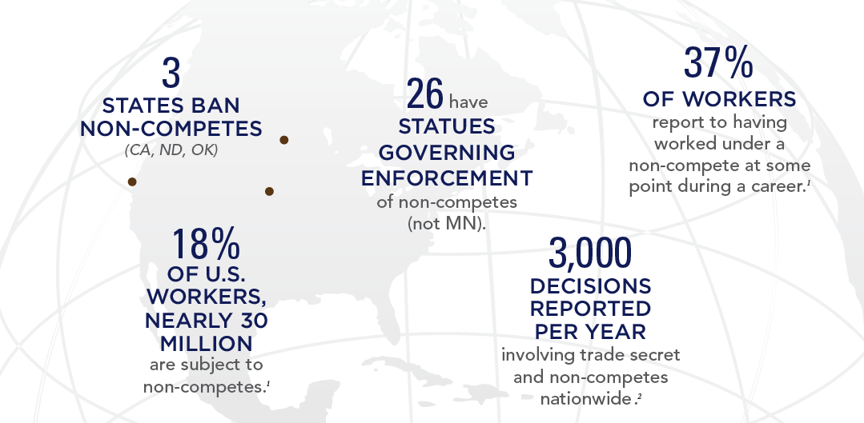
Non-Competes in the United States

Slide 91
Common Provisions in Non-Compete Agreements
Non-Compete Covenant
Non-Solicitation Covenant
Trade Secret/Confidentiality Provision
Anti-Raiding Provision
Shop Rights Provision

Slide 92
Requirements for an Enforceable Non-Compete
Independent Consideration
Protect Legitimate Business Interest
Reasonable in Scope, Duration, and Geographic Territory

Slide 93
Independent Consideration
Must confer a “real advantage” to an employee
Common Examples of Independent Consideration:
New Employment
Increased Compensation
One Time Bonus
Stock Offer
Promotion
Continued Employment is NOT Alone Sufficient

Slide 94
Legitimate Business Interest
Goodwill and Customer Relationships
Confidential Information and Trade Secrets
Specialized Training

Slide 95
Reasonable in Scope
Customer-Based or Product-Based Restrictions
Common Issues:
Preexisting customers brought by employee
Prospective customers
Cold call customers
Limited or no direct customer contact

Slide 96
Reasonable in Duration
Two Standards:
Length of time necessary so that employer’s customers no longer identify former employee as working for employer; or
Length of time necessary for employer to hire and train replacement employee
Two Years – Typically Reasonable in Minnesota

Slide 97
Reasonable in Geographic Territory
Fact Specific Depending on Business and Customers
Best Practice: Limit geographic scope to area where employee will actually work.
Using Non-Solicitation Provisions Instead of Geographic Restrictions

Slide 98
Other Key Non-Compete Provisions
Attorneys’ Fees and Expenses
TRO/Injunction & Irreparable Harm
Choice of Law and Venue
Tolling of Non-Compete Period

Slide 99
Other Key Non-Compete Provisions
Confidentiality Provision
Inventions
Return of Property
Defend Trade Secrets Act Disclosure
Notice to Prospective Employers/Notice to Company
Assignability

Slide 100
How do you enforce a non-compete?

Slide 101
Handling suspicions about employees
Cease and Desist Communications
Preserving Evidence / Forensic Examinations
Temporary Restraining Orders
Litigation
Damages

Slide 102
Hiring Someone with a Non-Compete

Slide 103
Hiring Someone with a Non-Compete
Is the applicant subject to a restrictive covenant?
Is the restrictive covenant valid?
What can the candidate still do for me?
How can I carefully draft the job offer?
Do I need to respond to this “cease and desist” letter?
I have been sued! Can I defend this?

Slide 104
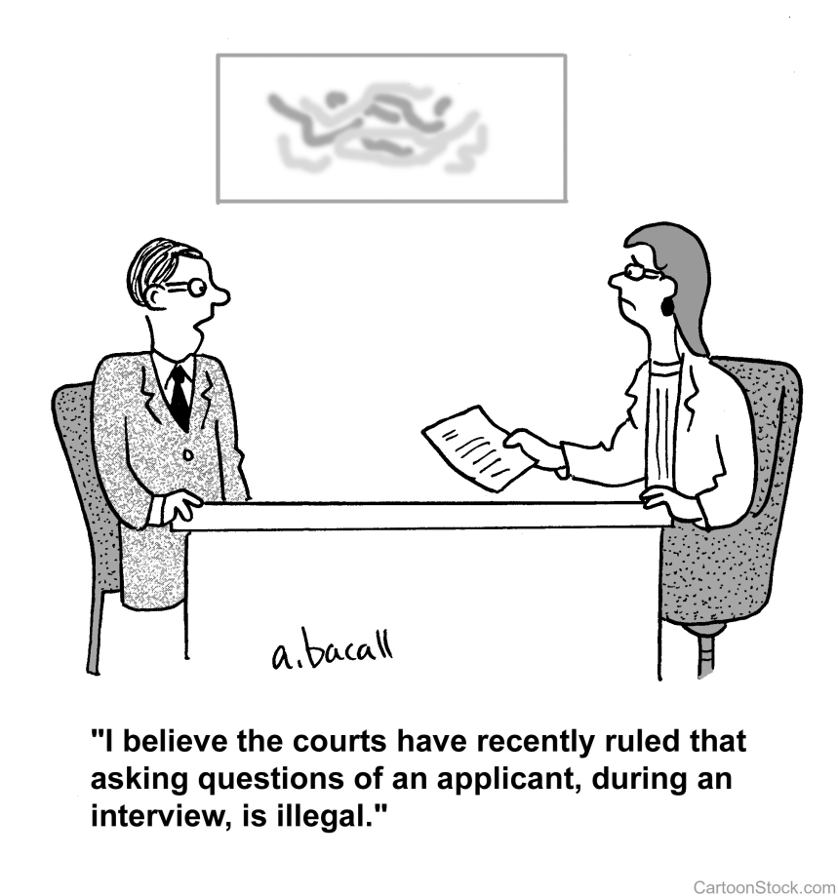
Is the Applicant Subject to Restrictive Covenant?
Make this inquiry early in the process
Often found in an employment agreement, but not always:
Stock option agreement
Deferred compensation agreement
Confidentiality agreement
Inventions agreement
If no, recite this in the offer letter and make offer contingent on absence of restrictive covenant
If yes, obtain a copy of the restrictive covenant

Slide 105
Is the Restrictive Covenant Enforceable?
Consult with outside legal counsel
Reasonable reliance on outside counsel is a defense to tortious interference claim
Choice of Law Provision
Consideration
Executed at the outset of prior employment
Non-illusory benefit conferred in connection with mid-employment restrictive covenant
Vague or Unreasonable in Scope
Temporal restriction
Geographic restriction
Customer solicitation restriction (words matter)
Notes:
Sysdyne Corp. v. Rousslang

Slide 106
Can the Applicant Function within Restrictions?
Assign employee to a different account/customer during restricted period
Assign employee to a different territory during restricted period
Assign employee to a different division during restricted period
Avoid “inevitable” disclosure of trade secrets
Avoid disclosure of confidential information
Notes:
For some positions/employers, this simply wont work and the employer should consider not hiring the employee.

Slide 107
Carefully Draft Employment Offer/Job Description
Disclose and enclose new restrictive covenant
Recite existence/non-existence of restrictive covenant
Precisely explain what conduct is prohibited
In all cases, explain that the employee cannot use/disclose former employer’s confidential and/or trade secret information

Slide 108
Offer Letter: Example 1
you are prohibited from, either directly or indirectly, providing products or services to any Globex Corporation customer or prospective customer with whom you worked during your last year of employment with Globex Corporation. You should understand that Acme Sales requires that you comply with these obligations. To the extent any such customer or prospective customer contacts you, you are required to inform the customer/prospective customer that you cannot work with them, either directly or indirectly.
As indicated in the attached Agreement, your offer of employment is contingent upon execution of the enclosed Employment Agreement, which contains restrictive covenants.
Re: Acme Sales Offer of Employment – Marcus Twain
Dear Mr. Twain:
Please consider this letter and the attached Employment Agreement your offer of employment from Acme Sales. As indicated in the attached Agreement, your offer of employment is contingent upon execution of the enclosed Employment Agreement, which contains restrictive covenants.
We at Acme understand that, pursuant to an agreement with your previous employer, you are prohibited from, either directly or indirectly, providing products or services to any Globex Corporation customer or prospective customer with whom you worked during your last year of employment with Globex Corporation. You should understand that Acme Sales requires that you comply with these obligations. To the extent any such customer or prospective customer contacts you, you are required to inform the customer/prospective customer that you cannot work with them, either directly or indirectly. Further, you may not utilize any confidential or trade secret information belonging to your previous employer. Any violation of your agreement with your previous employer or use of your previous employer’s confidential or trade secret information will result in discipline up to and including termination.
If you have any questions regarding these requirements of your employment with Acme Sales, please contact me.
Sincerely,
William Coyote, CEO
Further, you may not utilize any confidential or trade secret information belonging to your previous employer.

Slide 109
Offer Letter: Example 2
you are prohibited from, either directly or indirectly, providing products or services to the following customers: [Restricted Customers]. You should understand that Vehement Capital Partners requires that you comply with these obligations. To the extent any such customers contact you, you are required to inform the customer that you cannot work with them, either directly or indirectly
Re: Vehement Capital Partners Offer of Employment – Harriet Stowe
Dear Ms. Stowe:
Please consider this letter and the attached Employment Agreement your offer of employment from Vehement Capital Partners. As indicated in the attached Agreement, your offer of employment is contingent upon execution of the enclosed Employment Agreement, which contains restrictive covenants.
We at Vehement Capital Partners understand that, pursuant to an agreement with your previous employer, you are prohibited from, either directly or indirectly, providing products or services to the following customers: [Restricted Customers]. You should understand that Vehement Capital Partners requires that you comply with these obligations. To the extent any such customers contact you, you are required to inform the customer that you cannot work with them, either directly or indirectly. Further, you may not utilize any confidential or trade secret information belonging to your previous employer. Any violation of your agreement with your previous employer or use of your previous employer’s confidential or trade secret information will result in discipline up to and including termination.
If you have any questions regarding these requirements of your employment with Vehement Capital Partners, please contact me.
Sincerely,
Nancy Botwin, CEO

Slide 110
Offer Letter: Example 3
you are prohibited from, either directly or indirectly, providing products or services to any Hooli Corporation customer or prospective customer within a [##] mile radius of your prior employer’s branch located at [Former Employer Address]. You should understand that Hooli Corporation requires that you comply with these obligations. To the extent any customer or prospective customer from within the restricted territory contacts you, you are required to inform the customer/prospective customer that you cannot work with them, either directly or indirectly
Re: Hooli Corporation Offer of Employment – Jared Dunn
Dear Mr. Dunn:
Please consider this letter and the attached Employment Agreement your offer of employment from Hooli Corporation. As indicated in the attached Agreement, your offer of employment is contingent upon execution of the enclosed Employment Agreement, which contains restrictive covenants.
We at Hooli Corporation understand that, pursuant to an agreement with your previous employer, you are prohibited from, either directly or indirectly, providing products or services to any Hooli Corporation customer or prospective customer within a [##] mile radius of your prior employer’s branch located at [Former Employer Address]. You should understand that Hooli Corporation requires that you comply with these obligations. To the extent any customer or prospective customer from within the restricted territory contacts you, you are required to inform the customer/prospective customer that you cannot work with them, either directly or indirectly. Further, you may not utilize any confidential or trade secret information belonging to your previous employer. Any violation of your agreement with your previous employer or use of your previous employer’s confidential or trade secret information will result in discipline up to and including termination.
If you have any questions regarding these requirements of your employment with Hooli Corporation, please contact me.
Sincerely,
Richard Hendricks, CEO

Slide 111
Responding to a “cease and desist” letter
Evaluate the restrictive covenant
Evaluate employee’s conduct
Evaluate the employer’s potential motivation:
Bluster
Paranoia
Education
Preparing for litigation
Formulate response

Slide 112
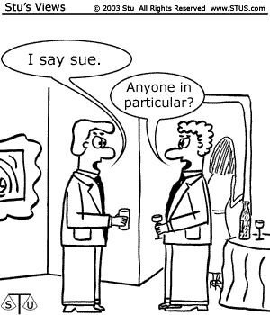
Defending Litigation Commenced by Former Employer
Even if new employer does everything right, it still may get sued
Tortious interference with contract
Tender to insurer
Preserve Emails/Documents

Slide 113
2018 Labor & Employment Law Update:
What Employers Need to Know
(November 2, 2018)

Slide 114
Grant T. Collins
(612) 373-8519
gcollins@felhaber.com
Daniel R. Kelly
(612) 373-8512
dkelly@felhaber.com

Slide 115
Where Are We Headed?
Regulatory Agenda under President Trump
State, Federal, and Local Law Update
Case Law Update

Slide 116
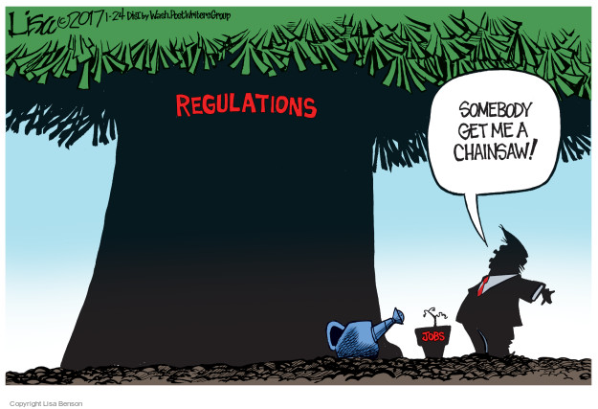

Slide 117
Trump’s Regulatory Freeze
On 1-1-17, President Trump issued a Memo stating no new regs until approved by Trump-appointed official.
On 1-30-17, Trump issued E.O. directing agencies to take 2 “deregulatory actions” for each new rule.
On 2-24-17, Trump issued E.O. directing agencies to create deregulation task forces.

Slide 118
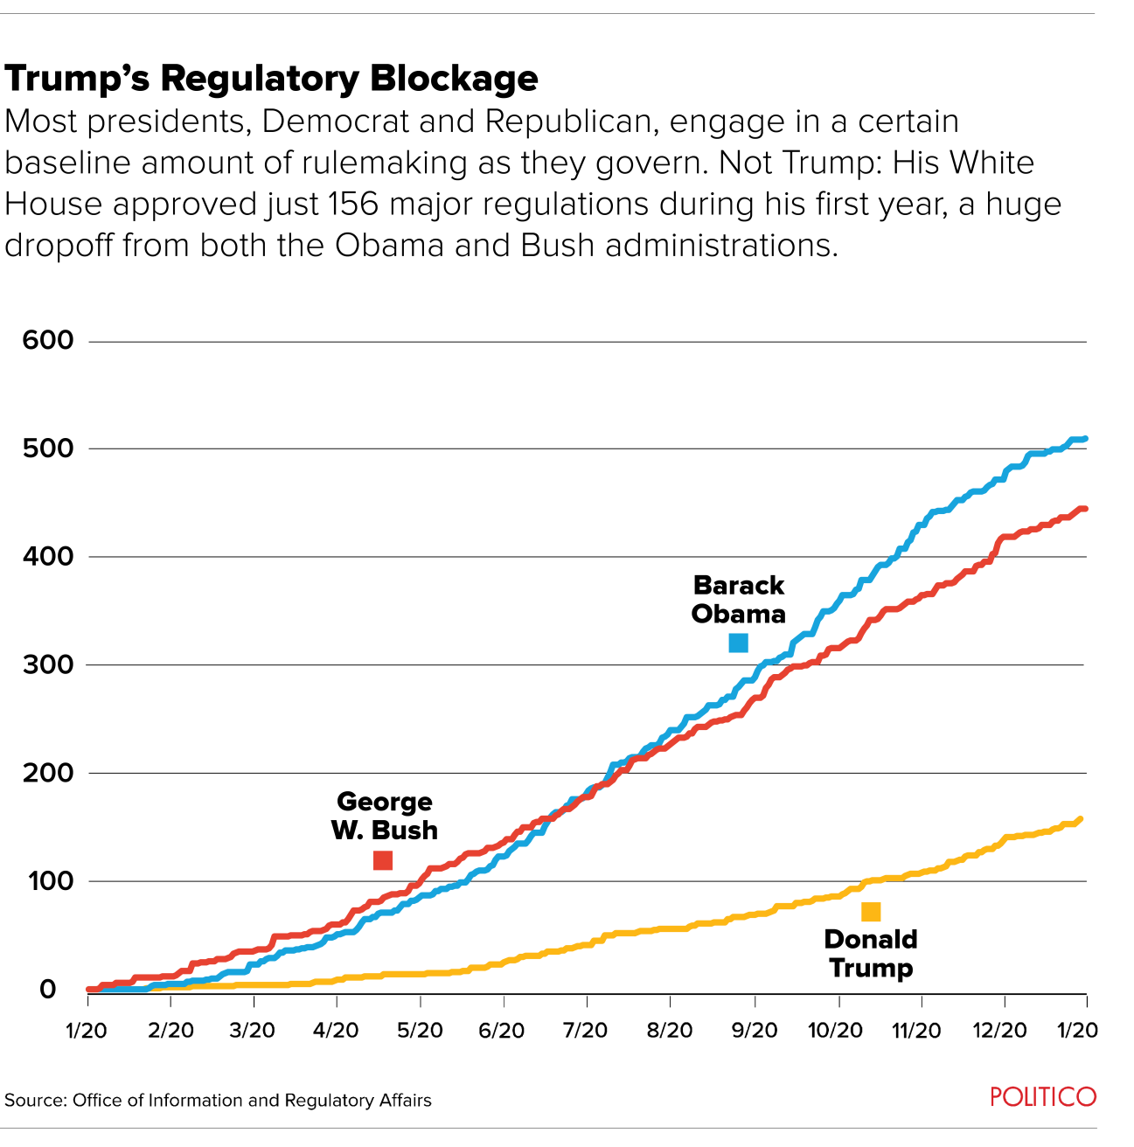

Slide 119
Dept. of Labor

Slide 120
Federal Contractors

Slide 121
Trump’s OFCCP
More Transparent
OFCCP publishes lists of employers being audited.
Fewer, Less Burdensome Audits
In Aug. 2018, OFCCP rescinded Directive 307 regarding analysis of SSAGs and PAGs.
Smaller OFCCP (possible merger with EEOC).

Slide 122
Am I a Federal Contractor?
Medicare Parts A and B and Medicaid
No, accepting reimbursement does not make a provider a federal contractor.
Medicare Parts C (Advantage Plans) and D (Prescription Drug Coverage)
Less clear, but likely treated as federal financial assistance (and thus excluded from OFCCP jurisdiction).

Slide 123
Am I a Federal Contractor? (cont.)
Examples of Covered Contracts
Providing health care to active or retired military under a contract with the Department of Veterans’ Affairs or the Department of Defense.
A teaching hospital doing research for a university that has a contract with the Federal government may be covered.

Slide 124
TRICARE Providers
A DOD health care program that pays for the medical benefits of active-duty and retired military personnel and their families.
Directive 2018–02 (amends Directive 2014–01)
Extends moratorium on enforcing the affirmative action obligations of TRICARE providers to 2021.
Expanded to include VA Health Benefits Program providers.

Slide 125
VA MISSION Act of 2018
Contractors that enter into agreements with the VA to provide hospital care, a medical service, or an extended care service are subject to the same affirmative action moratorium as is applied to TRICARE contractors and subcontractors in Directive 2014-01.
VA will likely need time to implement regulations and make the new provider agreements available.

Slide 126
Wage and Hour Division

Slide 127
Trump’s WHD
Less Enforcement, More Guidance
DOL Opinion Letters
New Regulations on the Horizon
Updates to Overtime, “Regular Rate” calculation, and joint employment.
Other changes possible.

Slide 128
“RIP” 2016 Overtime Rules
In 2016, new OT rate was scheduled to go into effect on 12-1-2016.
Would have increased salary threshold:
From $455 per week ($23,660) to “40th percentile” ($913 per week or $47,476).
HCE threshold increased from $100,000 to “90th percentile” ($134,004).
4.2 million more workers eligible for OT.

Slide 129
“New” Overtime Rules
11-22-16: Texas judge issues nationwide injunction.
08-31-2017: New OT regs struck down by judge.
09-06-17: 5th Circuit grants DOL’s unopposed request to dismiss its appeal.

Slide 130
DOL Sec. Alexander Acosta
Confirmed by Senate in April 2017
Clerked for Justice Alito.
Confirmation Hearing:
“I believe the salary threshold figure would be somewhere around $33,000,” which represents a COL increase since the last increase in 2004.

Slide 131
Overtime Rule 2.0?
In July 2017, DOL seeks public input (RFI) on 11 questions relating to OT threshold.
In August 2018, DOL holds public “listening sessions” regarding new OT rule.
What is the appropriate salary level (or range of salary levels)?
What are the costs and benefits?
Should it be updated regularly?

Slide 132
Fall 2018 Regulatory Agenda
Updates to OT Rule
DOL will update salary level.
Proposed Rules expected March 2019.
Updates to Calculation of “Regular Rate”
DOL wants to update rules to address “modern forms of compensation and benefits.”
Proposed rules expected December 2018.

Slide 133
Fall 2018 Regulatory Agenda
Updates to “Joint Employment” Standard
In June 2017, DOL withdrew Obama-era guidance on “joint employment” (FLSA 2016-1).
DOL wants to “clarify the contours of the joint employment relationship.”
Proposed Rules expected December 2019.

Slide 134
DOL’s New Intern Rule
DOL issued new guidance on January 5, 2018 to determine when a worker qualifies as an intern
Adopted the “primary beneficiary test” followed by multiple appellate courts
Under this test, the “economic reality” of the intern-employer relationship is examined to determine which party, either the intern or the employer, is the “primary beneficiary” of the relationship
If the employer is primary beneficiary → “employee” under FLSA
If the intern is primary beneficiary → not an employee
New rule consists of seven non-exhaustive factors

Slide 135
DOL Opinion Letters
DOL Opinion Letters are back!
Since January 2018, the DOL has issued 23 opinion letters addressing many different topics.
Not controversial, but helpful guidance.

Slide 136
FLSA Opinion Letters
On 1-5-18, the DOL “re-issued” 17 opinion letters that were withdrawn in 2009.
FLSA2018-1 (On-Call Time)
Five-minute response time for ambulance drivers was not so restrictive as to make the time compensable.
FLSA2018-11 (Regular Rate)
“Job bonus” must be included in “regular rate.”

Slide 137
FLSA Opinion Letters (cont.)
FLSA2018-18 (Travel Time)
Reaffirms that: (1) travel away from the employee’s home community is worktime if it cuts across the employee’s regular workday and (2) “time spent in travel away from home outside of regular working hours as a passenger on an airplane, train, boat, bus, or automobile” is not worktime.
“Normal work hours” can be calculated for employees with irregular schedules by (a) averaging hours or (b) establishing a schedule.

Slide 138
FLSA Opinion Letters (cont.)
FLSA2018-19 (Breaks)
Employee needs 15-minute breaks every hour due to a serious health condition under the FMLA.
DOL concludes that breaks required solely to accommodate the employee’s serious health condition, unlike ordinary rest breaks, are not compensable.
But, employee can use paid break time that is otherwise provided by the employer.

Slide 139
FLSA Opinion Letters (cont.)
FLSA2018-20 (Wellness Activities)
Employees voluntarily participate in “wellness activities,” including biometric screenings, education classes, gym, Weight Watchers, etc.
DOL concludes that voluntarily engaging in “wellness activities” is not compensable.
But, if an employee uses their paid break time (i.e., 20 min. or less), the time is still compensable.

Slide 140
FLSA Opinion Letters (cont.)
FLSA2018-21 (Retail Sales Exemption)
Employees selling credit card processing equipment to businesses could qualify for the retail-sales exemption.
Notes that exemptions receive a “fair (rather than narrow) interpretation” under Encino.
FLSA2018-22 (Volunteers)
Professionals who “volunteered” to grade exams for a professional organization were “volunteers” and not “employees.”
Payment of a fee and expenses did not change result.

Slide 141
FMLA Opinion Letters
FMLA2018-1 (Attendance Points)
No-fault attendance policy removes points after 12 months of “active service,” which is not defined but did not include FMLA leave.
By “freezing” points during FMLA leave, DOL concludes that the employee “neither loses a benefit that accrued prior to taking the leave nor accrues any additional benefit.”
However, the employer must treat equivalent forms of leave (e.g., non-FMLA leave) similarly.

Slide 142
New FMLA Forms
On 09-04-18, the DOL released the long-awaited new Family Medical Leave Act notices and certification forms.
New forms expire on 8-31-18.
https://www.dol.gov/whd/fmla/2013rule/militaryForms.htm

Slide 143
PAID Pilot Program
In March 2018, the DOL announced the Payroll Audit Independent Determination (PAID) pilot program.
Allows employers to self-report FLSA violations to the DOL and attempt to resolve the issues under the DOL’s “supervision.”
Limitations
Waiver is limited to the “limited to the potential violations for which the employer had paid back wages.”
State claims are not resolved.
Records are not confidential and may be subject to a FOIA request.
In Oct. 2018, the DOL extended the PAID Program through March 2019.

Slide 144
OSHA Update

Slide 145
OSHA’s “Improve Tracking of Workplace Injuries and Illnesses“ Rule
Issued: May 12, 2016.
Effective: Aug. 10, 2016, but OSHA delayed enforcement until Dec. 1, 2016.
Includes two components:
(1) Electronic Recordkeeping; and
(2) Anti-Retaliation.

Slide 146
“Electronic Reporting” Provision
Employers with 250+ employees or employers in “high risk” industries with 20-249 employees must electronically submit:
Form 300 (Log of Work-Related Injuries and Illnesses);
Form 301 (Injury and Illness Incident Report); and
Form 300A (Summary of Work-Related Injuries and Illnesses).

Slide 147
Electronic Reporting (cont.)
In July 2018, OSHA issued Proposed Rule (83 Fed. Reg. 36494)
Eliminates e-filing requirement for Form 300 and Form 301.
Form 301A would still need to be e-filed.
OSHA is not accepting e-filing of Form 300 and 301.

Slide 148
“Electronic Reporting” (cont.)
Form 300A Deadlines:
2016 Form 300A by December 31, 2017.
2017 Form 300A by July 1, 2018.
Beginning in 2019, by March 2.
Compliance has not been easy:
33% missed the December 31st deadline.
46% missed the July 1st deadline.

Slide 149
Anti-Retaliation Provision
Prohibits employers from discouraging workers from reporting an injury or illness.
2016 Rules provided guidance on:
(1) “Incentive Programs,”
(2) “Post-Accident Drug Testing,” and
(3) “Mandatory Reporting” Rules.

Slide 150
Anti-Retaliation (cont.)
Drug Testing
“[B]lanket post-injury drug testing policies deter proper reporting.”
Incentive Programs
Prohibits all programs in which employees are denied a benefit on the basis of any injury or illness report.
Mandatory Reporting Rules
Requiring immediate reporting could be retaliatory.

Slide 151
2018 OSHA Memorandum
OSHA rules do not prohibit post-incident drug testing.
Permissible Drug Testing, includes:
Random testing.
Drug testing unrelated to the reporting of a work-related injury or illness.
Drug testing under a state WC law.
Drug testing under DOT rules.
Drug testing to evaluate the root cause of a workplace incident that harmed or could have harmed employees.

Slide 152
2018 OSHA Memorandum (cont.)
With respect to post-accident testing, OSHA notes:
“If the employer chooses to use drug testing to investigate the incident, the employer should test all employees whose conduct could have contributed to the incident, not just employees who reported injuries.”
Thus, “blanket” post-accident testing policies may be OK if they apply only to “employees whose conduct could have contributed to the incident.”

Slide 153
2018 OSHA Memorandum (cont.)
Incentive Programs are permissible under OSHA rule.
Program that incentivizes reporting of “near-misses or hazards” is always permissible.
Rate-based incentive programs are permissible “as long as they are not implemented in a manner that discourages reporting.”
Rate-based programs require the employer to implemented “adequate precautions to ensure that employees feel free to report an injury or illness.”

Slide 154
2018 OSHA Memorandum (cont.)
Employers can counterbalance deterrents by “taking positive steps to create a workplace culture that emphasizes safety,” including:
An incentive program that rewards employees for identifying unsafe conditions;
A training program reinforcing reporting rights and responsibilities and emphasizes non-retaliation;
A mechanism for accurately evaluating employees’ willingness to report injuries and illnesses.

Slide 155
Transgender Bathroom
In 2015 OSHA issued “A Guide to Restroom Access for Transgender Workers.”
Employees should be permitted to use the bathroom of their gender identity.
Employees should not be asked “to provide any medical or legal documentation of their gender identity.”
To date, OSHA has not withdrawn the guidance.

Slide 156
DOJ and FTC

Slide 157
Antitrust Guidance for HR Professionals
In 2016, DOJ would “proceed criminally against naked wage-fixing or no-poaching agreements.”
Wage-Fixing Agreements Are Unlawful
Agreeing with individual(s) at another company about employee salary or other compensation, either at a specific level or within a range.
“No-Poaching” Agreements Are Unlawful
Agreeing with individual(s) at another company to refuse to solicit or hire that other company’s employees.

Slide 158
Antitrust (cont.)
On 04-03-18, DOJ settlement with rival railroad suppliers regarding “no-poaching” agreement.
Email between executives:
“You and I both agreed that our practice of not targeting each other’s personnel is a prudent cause for both companies.”
Information Sharing
Common issues include salary and benchmarking studies should be conducted by industry groups.

Slide 159
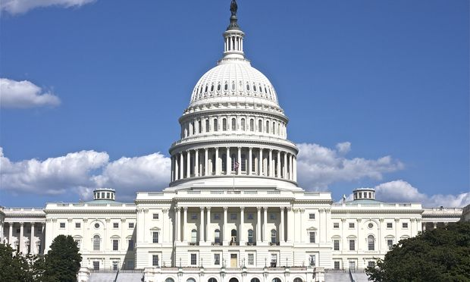
Federal Legislation

Slide 160
Potential Legislation
As of October 25, 2018, there were 303 bills relating to labor and employment.
Only 6 had passed.
Five of 6 bills were “disapproval” bill pursuant to CRA.

Slide 161
Tax Cuts and Jobs Act
Enacted December 17, 2017.
Amends tax code and prohibits tax deductions for any payment, including payments pursuant to a settlement agreement, that involve sexual harassment or abuse if the payment is subject to a nondisclosure agreement.
Deductions for attorney’s fees are prohibited if they relate to settlements or payments that include nondisclosure agreements that could prevent the disclosure of sexual harassment or assault.

Slide 162
Consolidated Appropriations Act of 2018
Signed into law on March 23, 2018.
Vacated DOL’s 2011 regulations barred tip pooling when employers do not claim a tip credit under section 3(m) of the FLSA.
DOL guidance in April 2018 provides that the FLSA does not prohibit employers “from allowing employees who are not customarily and regularly tipped – such as cooks and dishwashers – to participate in tip pools.”

Slide 163
Paid Family Leave
14% of workers have paid family leave
GOP Bill
Provides workers with 45% of their pay in a Social Security parental benefits for 12 weeks.
Democratic bill
Provides workers with 66% of pay for up to 12 weeks (or 60 working days).
Covers same absences as FMLA.

Slide 166
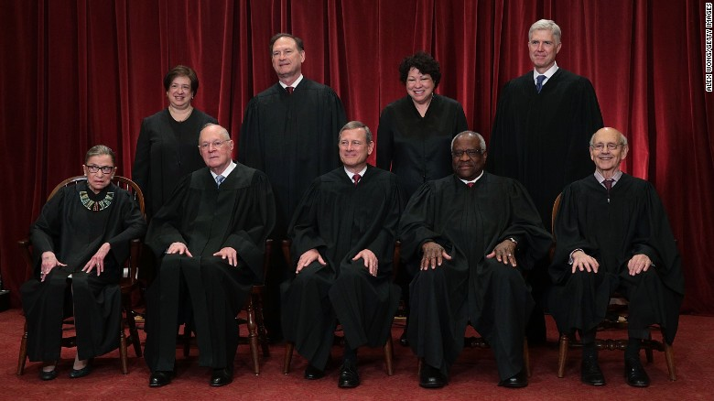
U.S. Supreme Court

Slide 167
U.S. Supreme Court
Democratic | Republican
Elena Kagan (56) | Neil Gorsuch (49)
Sonia Sotomayor (62) | Brett Kavanaugh (53)
Stephen Breyer (78) | Samuel Alito (66)
Ruth Bader Ginsburg (83) | John Roberts (62)
 | Clarence Thomas (68)

Slide 168
Encino Motorcars LLC v. Navarro, (April 2, 2018)
Group of “service advisors” sued their employer under the FLSA alleging that they were not paid OT.
Majority (5-4) held concluded that service advisors were “salesmen primarily engaged in servicing automobiles” as defined in the FLSA exemption.
Expressly rejected the principle that exemptions to the FLSA should be construed narrowly.

Slide 169
NLRB v. Murphy Oil USA, Inc., Epic Systems Corp. v. Lewis, and Ernst & Young LLP v. Morris, (May 21, 2018)
Majority (5-4) held that arbitration agreements providing for individualized proceedings must be enforced pursuant to FAA, and neither the Arbitration Act’s saving clause nor the NLRA suggests otherwise.
Dissent claimed that decision would result in “under enforcement” of employment laws.

Slide 170
Janus v. AFSCME Council 31, (June 27, 2018)
Majority (5-4) held public sector employees who are non-members of a union cannot be legally required to pay agency or “fair share” fees as a condition of employment.
“Fair share fee” assessed to non-members under Minn. Stat. § 179A.06, subd. 3 is now invalid.
Questions remain regarding enforceability of dues-deduction authorizations and refunding previously-deducted dues of non-members.

Slide 171
2018-2019 Cases
District v. Guido, U.S., No. 17-587
Does the 20-employee threshold for ADEA claims apply to public employers?
Lamps Plus Inc. v. Varela, U.S., No. 17-988
Did arbitration agreement waive class proceedings?
New Prime Inc. v. Oliveira, U.S., No. 17-340
Does FAA apply to long-haul trucker?

Slide 172
State Law Update

Slide 173
2017-2018 Legislature

Slide 174
2017-2018 MN Legislative Session
GOP Legislative Majorities
House: 76-57
Senate: 34-33
DFL Governor Mark Dayton
Session began on February 20, 2018 and ended on May 21, 2018.

Slide 175
Preemption of Local Legislation
H.F. 600 and S.F. 3 (2017 MN Legislature)
Preempts any local regulation of (1) “minimum wages,” (2) “paid or unpaid leave time,” (3) “hours or scheduling of work time” or (4) “requiring an employer to provide an employee a particular benefit, term of employment, or working condition.”
H.F. 600 stalled and Gov. Dayton vetoed S.F. 3 on May 30, 2017.

Slide 176
Legal Challenges (cont.)
H.F. 600 and S.F. 3 (2018 MN Legislature)
Reintroduced on February 28, 2018.
New Conference Committee selected in the House and Senate.
Was not repassed.

Slide 177
Wage History
H.F. 2913 (2018)
Prohibits an employer from “seek[ing] the wage history or information about past wages of an employee or prospective employee.”
Failed to pass.

Slide 178
Revised Definition of “Sexual Harassment”
H.F. 4459 and S.F. 4031 (2018)
Removes requirement that harassment be “severe or pervasive” in order to be actionable under the MHRA.
Standard was developed by the Supreme Court more than 30 years ago.
Failed to pass.

Slide 179
2018 Gubernatorial Election
Walz
Supports $15 minimum wage, “fair scheduling,” expansion of sick leave laws, and paid family leave.
Johnson
Does not support raising minimum wage.
Supports preemption legislation.

Slide 180
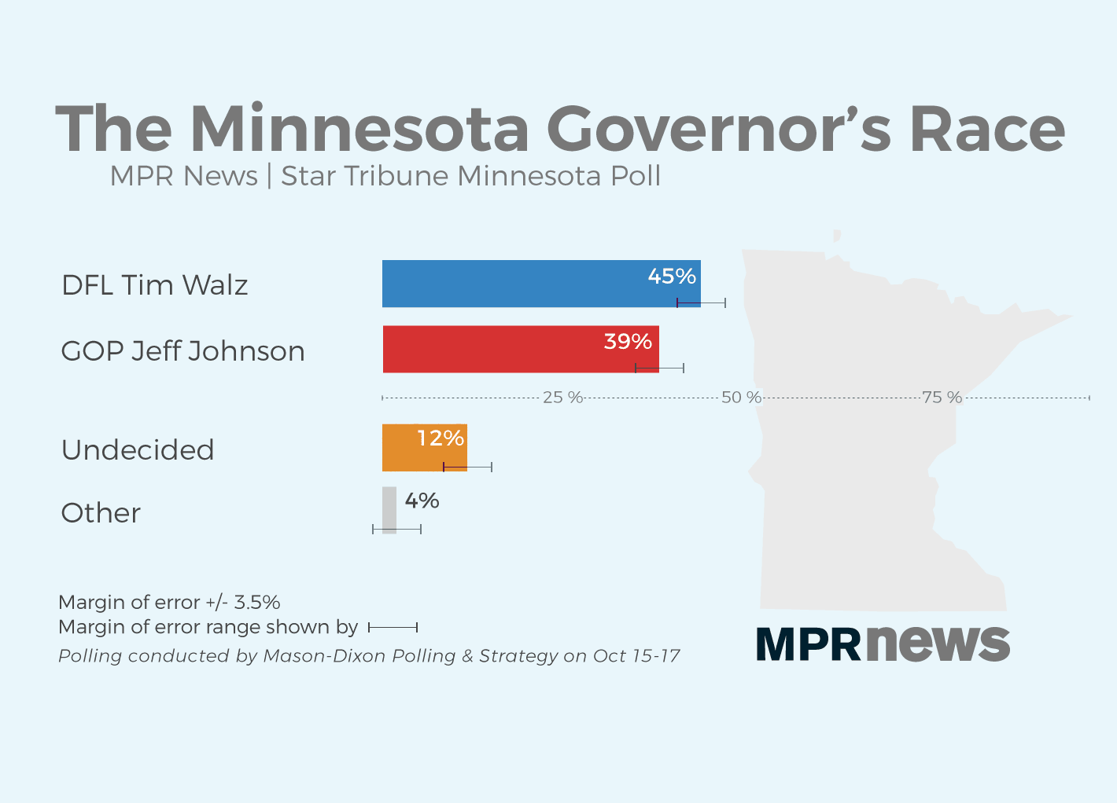

Slide 181
2018-2019 Legislature
Reconvene January 8, 2019.
Potential Legislation
Paid Family Leave
Pay Equity
Recreational Marijuana
Wage History
Preemption

Slide 182
Municipal Update

Slide 183
Sick Leave in the Twin Cities
Minneapolis Ordinance
Effective July 1, 2017
St. Paul Ordinance
Effective July 1, 2017 (23+ employees) or Jan. 1, 2018 (<23 employees)

Slide 184
Status of Legal Challenges
Minn. Chamber of Commerce v. Minneapolis, 27-cv-16-15051 (Minn. D. Ct. Jan. 19, 2017)
Court enjoined the City from enforcing its ordinance “against any employer resident outside the geographic boundaries of the City . . . .”
Both cities acknowledge that employer “residence” is required.

Slide 185
Legal Challenges (cont.)
Minn. Chamber of Commerce v. Minneapolis, A17-0131 (Minn. Ct. App. Sept. 18, 2017)
Appeals court agreed that the Ordinance was likely not preempted by state law.
But, court left in place the lower court’s injunction preventing the City of Minneapolis from enforcing its ordinance against non-resident employers.

Slide 186
Legal Challenges (cont.)
Minn. Chamber of Commerce v. Minneapolis, 27-cv-16-15051 (Minn. D. Ct. May 8, 2018)
Held that the Minneapolis ordinance was not preempted by state law.
“The City is therefore enjoined from enforcing the Ordinance against employers resident outside the geographic boundaries of the City of Minneapolis.”
Both parties have appealed (A18-0771)

Slide 187
Duluth Sick Leave Ordinance
In May 29, 2018, the Duluth City Council adopted an ESST ordinance.
ESST Ordinance:
Applies to employers with 5 or more employees.
Requires 1 hour of ESST for every 50 hours worked, up to 64 per year.
Carryover of up to 40 hours.
Effective January 1, 2020.

Slide 188
Minneapolis $15 Minimum Wage
Minneapolis passed a $15 Minimum Wage ordinance on June 30, 2017
Phased in over 5 years for businesses with 100+ workers
Phased in over 7 years for businesses with < 100 workers

Slide 189
Date | Large Businesses (100+ workers) | Small Businesses (< 100 workers)
Jan. 1, 2018 | $10 | No increase
July 1, 2018 | $11.25 | $10.25
July 1, 2019 | $12.25 | $11
July 1, 2020 | $13.25 | $11.75
July 1, 2021 | $14.25 | $12.50
July 1, 2022 | $15 | $13.50
July 1, 2023 | $15 indexed to inflation | $14.50
July 1, 2024 | $15 indexed to inflation | $15

Slide 190
MPLS Minimum Wage (cont.)
On Dec. 10, 2017, Judge Burke ruled in Minn. Chamber of Commerce et al v. City of Minneapolis, 27-cv-17-17198 that the minimum wage ordinance did not have extraterritorial effect.
Noted that the minimum wage ordinance applied only to “work actually performed within the city limits of Minneapolis.”

Slide 191
St. Paul $15 Minimum Wage
St. Paul City Council propose a $15 minimum wage ordinance in Oct. 2018.
Proposal would begin phasing in the wage hike in 2020:
100+ workers—$15 minimum wage by July 1, 2023.
6 to 100 workers—$15 an hour by July 1, 2025.
1 to 5 workers—$15 an hour by July 1, 2027.
No tip credit.

Slide 192
Other Case Updates

Slide 193
How Much Leave Is Too Much?
Under the ADA, there is a split on how much leave is a reasonable accommodation:
EEOC Guidance: Unpaid leave must be considered as an accommodation (unless undue hardship).
7th Circuit: held in Severson and Golden that a multi-month leave is never a reasonable accommodation.
8th Circuit: has not adopted Severson or Golden.

Slide 194
Severson v. Heartland Woodcraft, Inc., (7th Cir. Sept. 20, 2017)
In June 2013, Severson took a 12-week leave for a long-standing back problem.
At the end of his leave, Severson had surgery on his back, which would require that he be off work for another 2-3 months.
Severson asked Heartland to continue his leave of absence, but the company declined.
Instead, Heartland terminated his employment and invited him to reapply when he had recovered sufficiently to return to works.

Slide 195
Severson v. Heartland Woodcraft, Inc., cont.
Severson sued under ADA for failure-to-accommodate.
7th Circuit affirmed lower court’s dismissal of the case:
“The ADA is an antidiscrimination statute, not a medical-leave entitlement.”

Slide 196
Golden v. Indianapolis Housing Agency, (7th Cir. Oct. 17, 2017)
Golden suffered from breast cancer, requiring surgery and an extended leave.
As her 12 weeks of FMLA leave was about to expire, she sought an unspecified period of leave, which could have lasted as much as 6 months.
Her employer, the IHA, declined to grant more than four additional weeks of leave.
When Golden could not return from work after 16 weeks off (12 weeks of FMLA leave and 4 additional weeks), her employer terminated her employment.

Slide 197
Golden v. Indianapolis Housing Agency, cont.
Relied on Severson.
“A multi-month leave of absence is beyond the scope of a reasonable accommodation under the ADA.”
“A request for six months of medical leave in addition to the twelve weeks required by the FMLA removes an employee from the protected class under the ADA and the Rehabilitation Act.”

Slide 198
EEOC v. S&C Elec. Co., (N.D. Ill., April 10, 2018)
Rascher worked for S&C for 52 years.
In May 2014, Rascher was diagnosed with colon cancer and thereafter with melanoma.
In February 2015, he fractured a hip and was placed on an approved long-term disability leave (12 months) that was scheduled to end on August 29, 2015.
On August 15, 2015, Rascher contacted S&C to return to work.
Employer suggested that he retire and, when he refused, discharged him.

Slide 199
S&C Elec. Co., (cont.)
S&C moved to dismiss, relying on Severson, arguing that his 12 month leave meant he was not protected by the ADA.
Court held “nonsense.”
“Unlike the plaintiffs in Severson and Byrne he was ready, willing and able to return to his position without any accommodation.”
“Whether an individual is a qualified individual with a disability is determined at the time of the employment decision.”

Slide 200
Hostettler v. College of Wooster, (6th Cir. July 17, 2018)
Heidi Hostettler was hired as an HR generalist.
She was pregnant and provided 12 weeks of FMLA after her child was born, though she didn’t qualify.
At end of her leave, in April 2014, Hostettler was suffering from postpartum depression and anxiety. Requested a reduced work schedule for 2-6 months.
Returned in May on a reduced schedule of 3 days per week and, in July, she submitted updated medical information stating she could return to full-time in September.
College terminated her, and did not hire a replacement HR employee until October.

Slide 201
Hostettler, (cont.)
Reversed district court and held that summary judgment was inappropriate.
“On its own, . . . full-time presence at work is not an essential function. An employer must tie time-and-presence requirements to some other job requirement.”
“An employer cannot deny a modified work schedule as unreasonable unless the employer can show why the employee is needed on a full-time schedule; merely stating that anything less than full-time employment is per se unreasonable will not relieve an employer of its ADA responsibilities.”

Slide 202
Title VII and Sexual Orientation
Courts find that sexual orientation is protected by Title VII.
Hively v. Ivy Tech, (7th Cir. 2017)
Zarda v. Altitude Express, Inc., (2d Cir. Feb. 26, 2018)
In EEOC v. R.G. & G.R. Harris, (6th Cir. Mar. 7, 2018), the court extended Title VII’s prohibition against sex discrimination to include a prohibition of discrimination based on employee’s transgender status.

Slide 203
Title VII (cont.)
In Evans v. Georgia Regional Hospital (11th Cir. 2017), held that discrimination based on sexual orientation does not violate Title VII.
The Supreme Court denied cert. on Dec. 11, 2017.
As a result, the Circuit split will continue to grow.

Slide 204
Other 2018 Trends
#MeToo Movement
New laws to be expected.
Pay Equity
Both federal and state laws
Stricter Auditing of Contractors
OFCCP and state auditors (e.g., MDHR audits, including WCC and WESA).
Retaliation claims continue to grow

Slide 205
2018 Trends (cont.)
Definition of “Employee”
California adopts “ABC test” for workers in Dynamex Operations West, Inc. v. Superior Court, (Cal. April 30, 2018).
Drug Testing
On 02-01-18, Maine became first state to protect workers from adverse employment action based on their use of marijuana and marijuana products, provided the use occurs away from the workplace.

Slide 206
2018 Trends (cont.)
Salary History
CA, CT, DE, HI, KY, MA, NJ, NY, OR, PA, VT, WA prohibit the requesting an applicant’s salary history.
Sexual Harassment Training
Effective 1-1-19, California will have mandatory sexual harassment training for supervisors and non-supervisors.

Slide 207
2018 Labor and Employment Seminar
Grant Collins
Felhaber Larson
220 South 6th Street, Suite 2200
Minneapolis, MN 55402

Slide 208
Pay Equity and the New
Glass Ceiling

Slide 209
Summary
Current state of the wage gap
Federal laws prohibiting pay discrimination
Equal Pay Act of 1963
Title VII of the Civil Rights Act of 1964
State laws
Recent case law regarding pay discrimination
Reccommenations

Slide 210
What is Pay Equity?
“Equal pay for equal work.”
Origin: Male v. Female
Now, many state laws require equal pay across all groups
Sex, race, national origin, ethnicity, etc.
Pay equity is growing more complex as pay and work structures evolve.

Slide 211
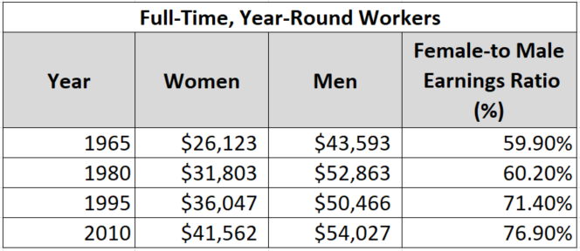
The Wage Gap – Historically
The wage gap has been slowly closing over time.
Ariane Hegewisch, The Gender Wage Gap: 2017; Earnings Differences by Gender, Race, and Ethnicity (2017).

Slide 212
The Wage Gap – Today
At the 10th percentile of wages, women earn 92 cents for every dollar paid to men.
At the 95th percentile of wages, women earn 74 cents for every dollar paid to men.
The average female worker loses more than $530,000 over the course of her lifetime.
The average college-educated female worker loses nearly $800,000 over the course of her lifetime.
Elise Goulding et al., What is the Gender Pay Gap and is it Real? (2016).

Slide 214
The Stalled Wage Gap
Since 1973:
60% of the wage gap change due to drop in men's real earnings.
40% of change due to increase in women’s earnings.
At current pace, the Institute for Women's Policy Research estimates that it will take 50 years to close the wage gap.

Slide 215
Federal Laws
Equal Pay Act of 1963 (EPA)
Title VII of the Civil Rights Act of 1964 (Title VII)
Lilly Ledbetter Fair Pay Act of 2009
Other federal laws ban discrimination in pay based on:
Age (ADEA)
Disability (ADA)

Slide 216
Federal Laws
Enforcement
EEOC -- independent federal agency created by Congress in 1964 to eradicate discrimination in employment.
EEOC wields great power and discretion in achieving the goal of eradicating discrimination in employment.
Under EPA and many state laws, plaintiff can bring a claim privately instead of first filing a charge with the EEOC or state equivalent.

Slide 217
Federal Laws
Enforcement
The EEOC has identified pay equity as one of six enforcement priorities.
In recent years, the EEOC has increased the number of EPA claims it has filed against employers.
2017: 11 EPA claims
2016: 6 EPA claims
2015: 5 EPA claims

Slide 218
Equal Pay Act
Creates as an amendment to the minimum wage provision of the FLSA.
Employers may not pay men and women differently for “equal work.”
The EPA defines “equal work” as work done:
In the same location;
Under similar working conditions; and
Using equal skill, equal effort, and equal responsibility.

Slide 219
Equal Pay Act
What is equal work?
“Substantially equal” – not “identical.”
Look at job content, not title.
What is equal pay?
All forms of pay. Examples:
Salary
Overtime and bonuses
Vacation
Benefits, stock options, and profit sharing.

Slide 220
Equal Pay Act
Affirmative Defenses:
Employers may provide unequal pay for equal work, if the differential in pay is attributable to:
A seniority system;
A merit system;
A system based upon quality or quantity of production; or
Any factor other than sex.

Slide 221
Equal Pay Act
Affirmative Defenses:
Merit, seniority, or incentive systems must be:
Based on predetermined criteria.
Applied consistently and even-handedly.
Communicated to all employees.
Must eliminate arbitrary decision making.

Slide 222
Equal Pay Act
Affirmative Defenses:
Merit system:
Raises based on high performance
Must evaluate employees regularly
Can contain subjectivity (supervisor rating), but must be otherwise objective.

Slide 223
Equal Pay Act
Affirmative Defenses:
Incentive system:
Pay is tied to quantity or quality of production
Common in sales jobs (i.e. commission)
Like merit systems, criteria must be objective and uniformly applied.
Seniority system:
Pay primarily based on length of service.

Slide 224
Equal Pay Act
Affirmative Defenses:
For all bona fide systems, the employer must show that the system is the true reason for the difference in pay.
Existence of system is not sufficient.
System must be related to business and to job requirements.

Slide 225
Title VII of the Civil Rights Act of 1964 (Title VII)
Prohibits discrimination in all aspects of employment.
Broader than EPA.
Prohibits wage discrimination on the basis of race, color, sex, religion or national origin.
Prohibits wage discrimination even when the jobs are not identical.
Thus, employee who has EPA claim likely has viable Title VII claim.

Slide 226
Title VII of the Civil Rights Act of 1964 (Title VII)
Must show:
Discriminatory intent; or
Facially neutral policy with disparate impact.
Need not show “equal work.”
Same affirmative defenses available under EPA are available under Title VII.

Slide 227
Lilly Ledbetter Fair Pay Act of 2009
The Act overturned the Supreme Court’s decision in Ledbetter v. Goodyear Tire & Rubber Co., 550 U.S. 618 (2007).
The court’s decision restricted the time period for filing complaints of pay discrimination.
The Act provides that the statute of limitations clock resets after each discriminatory pay decision.
Thus, each paycheck that contains discriminatory compensation is a separate violation.

Slide 228
State & Municipal Laws
Several states have taken lead in combatting pay equity.
Contain broader employee protections than federal laws
Mandate employers to make dramatic changes to workplace pay equity practices.
Audits
Compliance measures
Hiring practices

Slide 229
Minnesota
Local Government Pay Equity Act (1984)
Requires all public jurisdictions such as cities, counties, and school districts to eliminate any gender-based wage inequities.
Must report pay equity implementation report every 3 years.
Non-compliance results in fines and funding reduction.
Applies only to gender—not race, ethnicity, etc.

Slide 230
Minnesota
Statute has been effective in eliminating disparity.
1976:
4% of managers were women
25% of professional employees were women
2014:
30,000 state employees received raises
50.3% of state employees were female
46% of professional-level employees were female
Office on the Economic Status of Women, Pay Equity: The Minnesota Experience (Feb. 2016)

Slide 231
California
CA Equal Pay Act (1949)
CA Fair Pay Act (2016)
General rule:
No wage disparity for “substantially similar work.”
“Substantially similar work” is viewed as a composite of skill, effort, and responsibility.
This is broader than the EPA language – “equal work.”

Slide 232
California
Other protections:
Employer cannot justify pay disparity based on prior salary.
Plaintiff can compare wages between multiple offices/facilities.
Cannot prohibit employees from disclosing or discussing wages with others.
Can bring private right of action or file complaint with state division of labor.

Slide 233
California
Defenses:
Seniority;
Merit;
A system that measures quality or quantity of production; or
A bona fide factor other than sex (e.g., education, training, or experience) consistent with business necessity.

Slide 234
New Jersey
Similar to California
But, workers being compared must work in same “geographic region.”
Not limited to gender – prohibits discrimination across all protected classes.
Employer cannot prohibit discussion of wage information.
Can recover liquidated damages for willful violations.
300% of wages recoverable.

Slide 235
Other States
Washington and Maryland (similar to NJ and CA)
Oregon and Massachusetts
Provide employers some form of “safe harbor” if conduct pay equity analysis.
MA requires analysis within three years of action.
Cities have also enacted pay equity ordinances
E.g. New York City banned questions about salary history in hiring process.

Slide 236
Significant Cases
Salary History
Rizo v. Yovino (9th Cir. 2017)
Plaintiff, a public employee, challenged under EPA the county’s practice of using salary history to determine starting salary.
Plaintiff started at minimum-level salary based on prior job pay. Pay was below that of male peers.
County said pay policy was not based on sex.

Slide 237
Significant Cases
Salary History
Rizo v. Yovino (9th Cir. 2017)
9th Circuit ultimately held that policy violated EPA.
“Reliance on past wages simply perpetuates the past pervasive discrimination that the [EPA] seeks to eradicate.”
Prior job salary is not “job related.”

Slide 238
Significant Cases
Salary History
Lauderdale v. Illinois Dep’t of Human Servs. (7th Cir. 2017)
Upheld policy that based pay increases in part on prior salary.
Court: no EPA violation unless pay discrepancy based on sex. No proof here that plaintiff’s prior wages were lower because of sex discrimination.

Slide 239
Significant Cases
Salary History
Taylor v. White (8th Cir. 2003)
Female army employee challenged policy that resulted in her receiving lower salary than male counterparts.
Army argued that pay disparity was based on a salary retention policy intended to retain skilled workers and protect workers’ salaries.
Court: prior salary or salary retention policy is a “factor other than sex” allowed under EPA.

Slide 240
Significant Cases
Summary: Salary History
Federal circuit courts are split as to whether employers can rely solely on prior salary to meet the “legitimate factor other than sex” defense to an EPA claim.
7th and 8th Circuits: Employers can use prior salary to justify a pay disparity
6th, 9th, 10th, 11th Circuits: Use of a prior salary cannot alone justify a pay disparity.
Other Circuit Courts: No clear decision in either direction.

Slide 241
Significant Cases
EPA Retaliation
Donathan v. Oakley Grain, Inc. (8th Cir. 2017)
Female employee alleged she was not given same bonuses as male coworkers, among other inequities.
She emailed company president. Plaintiff’s manager then told president of likely layoff’s at facility.
Plaintiff laid off 8 days later.
DC held that company had valid reason to terminate

Slide 242
Significant Cases
EPA Retaliation
Donathan v. Oakley Grain, Inc. (8th Cir. 2017)
8th Circuit reversed, holding that there was sufficient evidence to believe plaintiff’s complaint was basis for termination.

Slide 243
Significant Cases
Who is an Employee under EPA?
Courts apply multi-factor test to determine employment status. Factors include:
Company’s ability to hire and fire employee;
Extent of company supervision over employee;
Sharing of profits, losses, and liabilities;
Reporting structure.

Slide 244
Significant Cases
Who is an Employee under EPA?
Cambpell v. Chadbourne & Parke LLP (SDNY 2017)
Female partner at law firm paid less than male partners brought claim under EPA
Firm argued partner is not an “employee” under the EPA
Court disagreed, and denied summary judgment to firm.

Slide 245
Significant Cases
Class Actions
Many pay equity claims are litigated as class actions.
Challenge employer’s formal policy, or allege “pattern or practice.”
New state laws have looser definitions of “equal work,” which may allow for larger classes of plaintiffs.

Slide 246
Significant Cases
Class Actions
Barrett v. Forest Laboratories, Inc. (SDNY 2015)
11 female pharmaceutical sales representatives alleged that company was paying male employees of equal or lesser seniority more money.
Plaintiffs successfully certified a nationwide collective action under the EPA.
Notice was sent to 2,000 potential class members. Over 350 opted in.
Settled in 2017 for $4 million.

Slide 247
Cases to Watch
Ellis v. Google, LLC (San Francisco Superior Court)
Class action under the California Fair Pay Act
Plaintiffs broadly challenged Google’s company-wade compensation policy.
Plaintiffs initially included almost all female employees
Court initially dismissed complaint as too broad.
Plaintiffs narrowed claims to 30 job titles among 6 “job families.”
Court allowed complaint to proceed to discovery.

Slide 248
Cases to Watch
Kassman v. KPMG, LLP (SDNY)
Class action for pay and promotion discrimination under EPA and Title VII.
After certification of EPA class, over 1,100 members opted in.
The plaintiffs seek over $400 million in damages.

Slide 249
Recommendations
Pay equity statutes are moving quickly
Almost every state has a pay equity law.
Laws are broadening to protect across sex, race, ethnicity, national origin, religion, etc.
Laws contain looser definition of “equal work” – make it easier to make out a claim.

Slide 250
Recommendations
Ensure Compliance with Current Law
Identify whether pay disparities exist.
Conduct analysis of pay across and between different groups.
Review hiring and promotion policies
Identify whether policies promote pay disparities.
Hire expert to review current merit, performance, incentive, or seniority systems
Must ensure system will justify any pay disparities.

Slide 251
Recommendations
Get Ahead of the Game for Future Legislative Changes
Review and amend policies regarding employee discussion of wages
Increase pay transparency.
Compare pay and policies with other company offices or locations.

Slide 252
2018 Labor and Employment Seminar
Brad R. Kolling
Dennis Merley
Felhaber Larson
220 South 6th Street, Suite 2200
Minneapolis, MN 55402

Slide 253
Return to Work

Slide 254
Is it a Disability or Serious Health Condition or Workers’ Compensation Injury?
Family and Medical Leave Act
Americans with Disabilities Act
Workers’ Compensation

Slide 255
Practice Tips
ALWAYS START WITH FMLA
Greatest benefits to employees
Most restrictions upon employers
Most precise legal obligations

Slide 256
Practice Tips
When FMLA ends, the ADA still lives on.

Slide 257
Practice Tips
Light duty and reasonable accommodation are not the same thing.
An employer is not required under the ADA to create light duty work for an employee.
Exception: If an employer “reserves” light duty work for employees who have workers’ compensation injuries, the employer cannot refuse to provide a reserved light duty job to an employee who has a non-workers’ compensation injury that is also a disability.

Slide 258
General Fact Scenario
Sunset Years has 80 employees.
Anne Price - CNA for 4 years.
She works a .8 position.
This year she has missed 10 days of work.
Company’s “no fault” policy only allows 10 missed days per year (never more than 2 days in a row). One more day and she is subject for termination under the policy.

Slide 259
The Injury
Anne scheduled to work Wednesday p.m.
That morning, calls in with back pain.
Has a doctor’s appointment and will call following the appointment.
Reports that her doctor has ordered bed rest for the next three days and she is to see the doctor again on Monday morning.

Slide 260
Part I – Initial Analysis Under Workers’ Comp.
How do you determine coverage:
Check # of employees (More than 50)
Check how long Anne has worked for Company (More than one year)
Check # of hours in the last year (At least 1,250)
Look at # of doctor visits (Two)
Look at # of days incapacitated (More than three)
Is Anne covered?

Slide 261
Part I – Initial Analysis Under ADA
What if she didn’t meet one or more of the FMLA thresholds for coverage?

Slide 262
Part I – Initial Analysis Under Comp
How do you determine coverage:
Investigate to find out if occurred at work
Get report of injury if alleged work related including mechanism of injury and body part(s) injured

Slide 263
After the Monday A.M. Appt.
Anne stops by the worksite and provides documentation and back injury is serious.
Doctor has restricted her ability to stand, walk and lift.
Work only 4 hours per day and change positions and sit as needed.
Doctor will see her again in two weeks.
Anne injured her back while preventing a resident from falling during her last shift.

Slide 264
Part II – FMLA Considerations
Is Anne eligible for coverage under FMLA?
What do you need to do?
What are you permitted to do?
Substitute accrued PTO for any part of leave.
Run FMLA leave concurrently with work comp.
Greater ability to authenticate & clarify leave.

Slide 265
Part II – ADA Considerations
What is your next step under the ADA analysis?

Slide 266
Part II – Workers’ Comp Considerations
If eligible for comp. benefits, “light duty” within the given restrictions is permissible.
However, FMLA does not run concurrently with “light duty”.
If Anne refused “light duty” within her restrictions, she could still be allowed the FMLA leave, but workers’ comp. benefits would not be paid.

Slide 267
Part III – Symptoms Continue
Anne’s symptoms continue and off work for 9 weeks.
She treats regularly and submits updates.
After 9 weeks, increased workability to 8 hours.
Still restricted on ability to stand and walk.
Anne requests return to old job.

Slide 268
Part III – RTW under FMLA
If Anne has been released to work full days, although with restrictions, is she eligible to return to work?
Under FMLA, she is entitled to reduced leave assuming she is able to return and perform the essential functions of her job
What happens if Anne can’t perform essential functions of her job?
Anne still has 3 weeks of FMLA leave
What happens if Anne has no more time and can’t perform essential job functions?
This is the critical “hand off” from FMLA to ADA

Slide 269
Anne Goes Home
Anne tried to do her Nursing Assistant job, but was unable to do the work.
You offer her temporary light duty performing office work.
She declines and goes home for the remaining 3 weeks of FMLA time.
At the end of 3 weeks she tells you she needs another 4 weeks off and then she “should be fine.”

Slide 270
Part IV – Failed RTW & FMLA
Does the fact that you offered the temporary light duty cut off entitlement to any remaining FMLA?
No – If she still has a serious medical condition that prevents her from working and has remaining FMLA she is allowed her 12 full weeks of FMLA leave.

Slide 271
Part IV – Failed RTW & FMLA (cont.)
Do you have to continue to hold her position open?
Not under FMLA – Now ADA really matters
Can you terminate Anne at the end of her FMLA leave?
Yes under FMLA but not under ADA
Do you have to give Anne additional leave?
Probably
Do you have to consider “reasonable accommodations” under FMLA?
Not under FMLA

Slide 272
Part IV – Failed RTW & ADA
Was the temporary light duty that you offered an accommodation?
No – Light duty was only temporary and it was a different job.
Does the fact that you offered the temporary light duty and she declined it, alter your obligations under the ADA?
No – Not an accommodation to her actual job.

Slide 273
Part IV – Failed R.T.W. & Comp.
Does the fact that Anne turned down “light duty” work change her entitlement to ongoing work comp benefits?
Yes, if she was released to work with restrictions and the work offered was within those restrictions
Still would be protected under FMLA
If no remaining FMLA look to ADA

Slide 274
Facts
Assume Anne is ready to come back 6 weeks later.
She returns to work with lifting and bending restrictions.
The restrictions are for the next 6-9 months.

Slide 275
RTW under ADA
What is your next step under the ADA analysis?
Look at severity of condition
Look at essential functions of job and ability to perform functions
Engage in interactive process regarding accommodation
Given her ongoing restrictions from the doctor, does Anne qualify for ADA coverage?
An even stronger probably

Slide 276
RTW under ADA (cont.)
Do you return Anne to her old job?
If able, engage in interactive process
Return to her old job if she can perform essential functions of job with reasonable accommodations
Accommodation of last resort
Anne’s job was filled while she was out on leave. Do you have to find her another job within the company?

Slide 277
Conclusions (cont.)
When one or both of the federal statutes conflict with state laws, the federal laws take precedence if the federal laws are more restrictive.
When in doubt over complexities, seeking assistance of counsel on ADA and FMLA issues is wise.

Slide 278
Conclusions (cont.)
Because Anne has been out due to a work injury, do you have a greater obligation to return her to her pre-injury job?
No greater obligation to return to same job
Suitable job (hours, pay, abilities) is generally sufficient under Comp
But remember FMLA (if return within 12 weeks) or ADA

Slide 279
Dueling Doctors
You decide that you would like to get another opinion on Anne’s physical condition and capabilities.
Independent Medical Exam (IME) takes place.
IME doctor opines unrestricted work.
Anne’s doctor is still restricting her walking, standing and lifting abilities.

Slide 280
Part V – Dueling Docs & FMLA
Can you terminate Anne if she is unwilling to return to work unrestricted
Not if she still has FMLA leave and her doctor is providing documentation that she has a serious medical condition that prevents her from working
What if she doesn’t have any more leave?
Do you have to give Anne additional leave?
Not under FMLA, but probably under ADA

Slide 281
Part V – Dueling Docs & FMLA
Which doctor opinion and restrictions govern? Do you have to consider both in making decisions?
Yes – Interactive process must begin
How do you proceed if Anne insists on following her doctor’s restrictions?
Do you have to discuss accommodations even though the IME doctor for the work comp case gives full return to work?

Slide 282
Part V – Dueling Docs & Comp
Under Comp can you tell Anne that you are following IME doctor’s recommendations, offer her pre-injury job and advise her that temporary light duty no longer available?
Yes; however, could spark an ADA issue relating to a disability and a failure on part of Employer to engage in interactive process and failure to accommodate a disability

Slide 283
Part V – Dueling Docs & Comp (Cont.)
Do you have to continue to provide work within treating doc’s restrictions or pay wage loss benefits if Anne refuses?
No; however, likely results in comp litigation to be decided by ALJ
ADA would require interactive process

Slide 284
Part VI – Request for Accommodation
Anne returns after using up her 12 weeks of FMLA leave.
Wants to go back to her old job.
She tells you that she can do the job with following accommodations:
Sit for 5-10 minutes every hour.
Assistance on lifts.
Allowed to report to work a half-hour late one day a week to allow medical treatment.

Slide 285
Part VI – FMLA
What does Anne have to provide to you to allow her return to work?
If told in advance Fitness for Duty
If serious doubts about abilities IME may be permissible

Slide 286
Part VI – Request for Accommodation under ADA
Do you have to accommodate Anne’s requests under the ADA?
Possibly – Engage in interactive process
What do you consider in arriving at your decision?
Essential functions
Reasonableness of request
Cost should not be primary consideration

Slide 287
Part VI – Request for Accommodation under Comp
Does the IME doctor’s opinion change your decision on the issue of accommodating Anne’s requests?
Under Comp, you do not need to accommodate but ADA would require interactive process and consideration of request to accommodate
If you do not accommodate Anne’s requests, is she entitled to ongoing wage loss benefits?
Not automatically – If ALJ says yes, then yes

Slide 288
Conclusions
The statutory and common-law areas of the ADA (ADAAA), FMLA and Workers’ Compensation overlap and sometimes conflict in some way with one another.
Consequently, there are a few general rules to consider when trying to determine the correct action to take under the laws:

Slide 289
Conclusions (cont.)
Try to comply with all of the restrictions if possible.
In situations where the restrictions imposed by the laws appear to be in conflict compliance with the strictest restrictions is best bet.

Slide 290
Penelope J. Phillips
(612) 373-8428
pphillips@felhaber.com

Slide 291
2018 Annual Labor & Employment Seminar
Sexual Harassment in the
#MeToo Era

Slide 292
#MeToo Movement Defined
#MeToo Movement: movement to increase awareness of sexual harassment and assault
- SCOTUS, Minn. Voters All. v. Mansky, 138 S. Ct. 1876 (2018)

Slide 293
#MeToo Impact On EEOC

Slide 294
EEOC Recent Developments
Proposed Enforcement Guidance on Unlawful Harassment
Promising Practices for Preventing Harassment Guidance
Checklists
Leadership and Accountability
Anti-Harassment Policy
Harassment Reporting System and Investigations
Compliance Training
Risk Factors and Responsive Strategies

Slide 295
#MeToo Impact on EEOC Enforcement In FY 2018
50% increase in lawsuits challenging sexual harassment filed by EEOC
12% increase in charges alleging sexual harassment filed with the EEOC
1200 charges resulted in reasonable cause findings
$70 million recovered for victims of sexual assault

Slide 296
What Are Employers Doing In Response to #MeToo?
Rethinking how they choose to investigate
Anonymous online complaints?
Harasser is a “model employee”?
Conduct off premises and after hours?

Slide 297
What Are Employers Doing In Response to #MeToo?
Reevaluating sexual harassment training programs and policies
Live and online interactive trainings
Targeted trainings for different levels of employees
i.e., management, supervisors, employees

Slide 298
What Are Employers Doing In Response to #MeToo?
Revising reporting and investigation of sexual harassment claims
Making it easier to make an internal complaint
Improving HR’s ability to investigate complaints
Obtaining outside counsel to investigate complaints

Slide 299
What Are Employers Doing In Response to #MeToo?
Reviewing consensual relationship policies
Upholding appropriate boundaries?
Prohibiting or just discouraging manager/subordinate relationships?
Right to modify reporting structures included?
Prohibiting physical contact at work?
Does it manage the risk of unlawful discrimination claims?

Slide 300
What Are Employers Doing In Response to #MeToo?
Opting for culture shifts
Less alcohol and more food options at company events
Actively engaging internal or external individuals to monitor suspicious and/or inappropriate behavior at company events

Slide 301
To avoid liability Employers Must Have Harassment Policies
Having an easy to understand, comprehensive, and enforced harassment policy is non-negotiable.
It is the first step toward protecting employees from harassment.

Slide 302
Policy Basics: Employee Responsibilities
If an employee believes that he/she has been subject to inappropriate behavior, the employee must report the behavior so the employer can conduct an investigation and stop the behavior if it is occurring.

Slide 303
Policy Basics: Employer Responsibilities
If an employer receives a report of inappropriate behavior or the employer is aware or becomes aware of potentially inappropriate behavior, the employer must conduct an investigation and if the behavior is substantiated, it must take timely and appropriate action to stop the behavior.

Slide 304
Employer Liability When a Supervisor Is the Harasser
An employer will be held strictly liable for harassment if it is done by a supervisor and culminates in a tangible employment action. Burlington Indus., Inc. v. Ellerth, 524 U.S. 742 (1998); Faragher v. City of Boca Raton, 524 U.S. 775 (1998).

Slide 305
Employer Liability When a Supervisor Is the Harasser
Faragher/Ellerth Defense: If the supervisor’s harassment does not culminate in a tangible employment action, the employer can avoid liability under the Faragher/Ellerth defense if it can show:
It exercised reasonable care to prevent and promptly correct harassing behavior; and
The complainant unreasonably failed to take advantage of preventative or corrective measures made available to her.

Slide 306
What Is Timely and Appropriate Action?
As soon as employer knows or should reasonably know that harassment may have occurred, the employer is required to take timely and appropriate action, including:
A prompt, thorough, and fair investigation;
Effective protective steps; and
Monitoring.

Slide 307
What Employers Must Do
Train employees and supervisors on what behaviors constitute harassment in the workplace and what to do about harassment.
Adopt a harassment policy that is enforced and accessible to employees.
Know what constitutes a report of harassment.
Investigate reports of harassment promptly and appropriately, and take appropriate corrective action.
Save investigation report and documents collected.
Continue to monitor the workplace to ensure that the harassment has stopped.

Slide 308
EEOC Checklist: Key Elements of Harassment Policy
Applies to employees at every level, applicants, clients, customers, etc.
Prohibits harassment based on any legally protected class
Describes prohibited conduct
Encourages reporting and participation in investigations

Slide 309
EEOC Checklist: Key Elements of Complaint System
Multiple complaint avenues, including to report senior leaders
Responsive to complaints
Provides prompt, thorough, and neutral investigations
Provides for follow-up with the complainant

Slide 310
EEOC Checklist: Train Your Managers
Not every employee comes forward and reports harassment.
Managers must recognize harassment and when they are “on notice” about harassment.

Slide 311
Training: What Is A Report of Harassment?
The standard is that the employer knew or should have known that harassment was occurring.
For example, a report of harassment includes:
An employee complains either orally or in writing about harassment toward them or another;
A supervisor observes harassment; and/or
Any other conduct or observation that puts the employer on notice that harassment has occurred.

Slide 312
How Can a Report Be Communicated?
All manners of communication can convey a report of harassment.
An employee has made a report regardless of whether it is by:
E-mail, text message, note, letter, or memo;
Phone call, hotline call, or voicemail;
Snapchat, Tweet, or social media message or post;
Sign language;
Scribbles on a bathroom wall; or
Other form of communication.

Slide 313
I Don’t Like Working With . . .
What should you do if an employee tells you that they don’t like or feel comfortable working with a particular co-worker, supervisor, or customer?
Follow up and ask why.

Slide 314
Example: Other Employees Are Being Harassed
Sheri often worked alone with her supervisor, Thomas.
Thomas sexually harassed Sheri. He repeatedly and forcibly kissed Sheri on the lips, puller her against him, came up behind to massage her neck, and sent sexually-suggestive messages to her work computer.
Although Sheri’s employer had a written anti-harassment policy that she was asked to read and sign on her first day, she never reported the harassment.
Why? Sheri knew Thomas was “nasty,” and with her daughter needing treatment for cancer, she could not take any chances on losing her job and health insurance.

Slide 315
Example: Other Employees Are Being Harassed
Thomas’s conduct toward Sheri was not unique. During the holiday season each year, Thomas asked Sheri and other female employees to kiss him under the mistletoe. Thomas also hugged and kissed other female employees, and made unwanted physical advances toward women in authority positions, including the Chief Clerk and a Commissioner.
Was there sufficient notice to the employer that the supervisor might be sexually harassing Sheri? The Third Circuit held that it was a jury question as to whether the employer “exercised reasonable care to prevent and correct promptly any sexually harassing behavior” because even though Sheri did not report the harassment, other people in authority positions knew that Thomas was harassing other women.
Minarsky v. Susquehanna Cnty., 896 F.3d 303 (3d Cir. 2018)

Slide 316
#MeToo Impacted Third Circuit’s Decision
The Third Circuit explained that the #MeToo movement influenced its decision in Minarsky v. Susquehanna Cnty., 896 F.3d 303 (3d Cir. 2018):
“This appeal comes to us in the midst of national news regarding a veritable firestorm of allegations of rampant sexual misconduct that has been closeted for years, not reported by the victims. It has come to light, years later, that people in positions of power and celebrity have exploited their authority to make unwanted sexual advances. In many such instances, the harasser wielded control over the harassed individual’s employment or work environment. In nearly all of the instances, the victims asserted a plausible fear of serious adverse consequences had they spoken up at the time that the conduct occurred.”

Slide 317
#MeToo Impacted Third Circuit’s Decision
“While the policy underlying Faragher-Ellerth places the onus on the harassed employee to report her harasser, and would fault her for not calling out this conduct so as to prevent it, a jury could conclude that the employee’s non-reporting was understandable, perhaps even reasonable. That is, there may be a certain fallacy that underlies the notion that reporting sexual misconduct will end it. Victims do not always view it in this way. Instead, they anticipate negative consequences or fear that the harassers will face no reprimand; thus, more often than not, victims choose not to report the harassment.”

Slide 318
An Employee Makes a Complaint – What Should an employer Do?
Tell the employee you take his/her concerns seriously
Don’t minimize the behavior or be dismissive
Don’t ask if there are witnesses (yet)
Do something!

Slide 319
EEOC Proposed Guidance: Investigation Depends on Circumstances
An investigation is effective if it is sufficiently thorough to arrive at a reasonably fair estimate of truth.
The investigation need not entail a trial-type investigation, but it should be conducted by an impartial party and seek information about the conduct from all parties involved.
Conflicting versions of relevant events may require credibility assessments of witnesses.

Slide 320
EEOC Proposed Guidance: Example of Inadequate Investigation
Brandon, a construction worker, repeatedly complains to the superintendent that he is being sexually harassed by Phil, the foreman in charge of Brandon’s crew.
After about two weeks, the superintendent asks a friend of his to conduct an investigation, even though this individual is not familiar with EEO law or the harassment policy and has no experience conducting harassment investigations.

Slide 321
EEOC Proposed Guidance: Example of Inadequate Investigation
Another week later, the investigator contacts Brandon and Phil and meets with them individually for about 10 minutes each. During the meeting with Brandon, the investigator never asks him any questions and does not take any notes.
Without first consulting with the EEO office, the investigator issues a single-page memorandum concluding that there is no basis for finding that Brandon was sexually harassed, but does not provide any explanation.
Under these circumstances, the employer has not conducted an adequate investigation.

Slide 322
Recent EEOC Settlement Example: Inadequate Investigation
Male and female customer service employees reported sexual harassment by managers and coworkers to onsite HR staff.
HR failed to:
Adequately investigate the complaints
Adequately discipline the harassers
Follow complaint procedures
Take sexual harassment complaints seriously
HR also actively deterred employees from making sexual harassment complaints.
Result: The EEOC brought suit against the employer, and the parties agreed to a $3.5 million settlement.
EEOC v. Alorica, Inc., No. 17-1270 (July 31, 2018)

Slide 323
Example: Telling Employee to “Deal With It”
Cole was a male truck driver who was harassed by his co-worker, Dan, for five years.
Dan harassed Cole by:
repeatedly lying to new employees by telling them that Cole was gay, even though he was not;
put Cole in a headlock and pretended to kiss him;
brushed Cole’s buttocks with his hands;
rubbed his genitals on Cole’s arm;
showed Cole pornographic images on his phone; and
pinched his nipples, among other harassing conduct.

Slide 324
Example: Telling Employee to “Deal With It”
Cole’s supervisors knew about the harassment, but told him to deal with it.
After one particularly egregious touching, Cole reported the harassment to his supervisors.
A week later, the employer laid Dan off. Cole then had to drive Dan’s truck – which smelled of Dan’s body odor – and work an extra night a week.
Someone from upper management commented to Cole that he was glad that the harassment did not happen to a female.
Jury verdict: $2.6 million in favor of employee.
Hudson v. Beverly Fabrics, Inc., No. CISCV182035 (Cal. 2018).

Slide 325
How Do You Conduct An Investigation?
Select an appropriate investigator
Gather policies and procedures
Figure out what happened
Take appropriate corrective action

Slide 326
STEP ONE: Select An Appropriate Investigator
Analytical: detail-oriented, gather and organize facts efficiently and effectively, and make recommendations
Credible: trusted and skilled in investigative role, well-respected
Knowledgeable about discrimination/harassment: understands legal implications and actionable conduct
Neutral: no connections with parties
Trusted: handles confidential/sensitive information in appropriate and professional manner
Objective: acknowledges own biases and avoids allowing them to affect judgment
Personable: welcoming and listens to each person to share story

Slide 327
When to Consider a Third Party Investigator
The person accused holds a high-level leadership position
The people who would typically investigate the complaint are either involved or cannot remain neutral
The complaint involves issues that HR does not have the right experience and training to handle

Slide 328
STEP TWO: Gather Policies and Procedures
Gather, at a minimum:
Discrimination policy
EEO policy
Harassment policy
Whistleblower and retaliation policy
Code of Conduct
Union contracts (grievance procedures, conduct standards)

Slide 329
STEP THREE: Find Out What Happened
Collect facts and relevant evidence
Determine witnesses and involved individuals
Determine who, what, when, where, why, and how
Evaluate credibility
Identify and eliminate extraneous information

Slide 330
STEP FOUR: Appropriate Corrective Action
Make a decision for appropriate corrective action
Any discipline should be prompt and proportionate to the behavior(s) at issue and the severity of the infraction, and be consistent with discipline of other employees
No retaliation

Slide 331
Example: Discipline the Harasser Appropriately
David worked at a steel plant with a co-worker named John. John made sexual comments to David, and inappropriately touched him.
David complained to his manager and HR, and was transferred to another part of the plant so he would no longer work directly with John. HR disciplined John for his behavior with a verbal warning, a one-week suspension, a demotion, and required him to take a leadership class. The harassment stopped.
HELD: No employer liability because the employer’s response was “adequate,” noting that “a response is adequate if it is reasonably calculated to end the harassment.”
Hylko v. Hemphill, 698 Fed. Appx. 298 (6th Cir. Oct. 3, 2017).

Slide 332
EEOC Proposed Guidance: Intermediate Action
When serious allegations have come forward, what intermediate steps to address the situation should the employer take while it determines whether a complaint is justified?
Consider taking the following measures:
Scheduling changes to avoid contact between the parties;
Temporarily transferring the alleged harasser; or
Placing the alleged harasser on non-disciplinary leave with pay pending the conclusion of the investigation.

Slide 333
EEOC Proposed Guidance: Intermediate Action
As a rule, employers should make every reasonable effort to minimize the burden or negative consequences to an employee who complains of harassment, pending the employer’s investigation.

Slide 334
What Should You Do If Employees Are Being Harassed By Customers?
Investigate the complaint in the same way the employer would if an employee was the harasser
Take action to stop the harassment depending on the circumstances, which may include:
Informing the customer that they will be banned if they continue harassment.
Banning the customer.
Finding a way that the employee will not need to deal with that customer.
Do not retaliate against the employee.

Slide 335
Training for Employers
Training must be emphasized at the organizational level, at the employee level, and at the supervisor and manager level.

Slide 336
EEOC Checklist: Training at Organizational Level
Championed by senior leaders
Repeated and reinforced regularly
Provided to employees at every level and location of the organization
Conducted by qualified, live, interactive trainers
If live training is not feasible, designed to include active engagement by participants

Slide 337
EEOC Checklist: Training at Employee Level
Examples tailored to the specific workplace and workforce
Information about employees' rights and responsibilities if they experience, observe, or become aware of conduct that they believe may be prohibited
Encourages employees to report harassing conduct

Slide 338
EEOC Checklist: Training at Manager Level
Information regarding how to prevent, identify, stop, report, and correct harassment
Risk factors and specific actions that may minimize or eliminate risk of harassment
Explains consequences of failing to fulfill their responsibilities related to harassment, retaliation, and other prohibited conduct

Slide 339
Key Takeaways
Bottom Line
An employer cannot absolutely control what happens at every location at all times of the work day.
What employers must do:
Have sexual harassment policies and other types of harassment policies in order.
Provide an appropriate response when claims are reported, including an investigation when warranted.
Take effective remedial action when misconduct is determined.
Prohibit discrimination and harassment based on other protected classes beyond sex.

Slide 340
Don’t Forget About Other Protected Classes
Additional protected classes beyond sex are also protected by federal, state, or local law.
Employers are required to know and prohibit discrimination and harassment based on both federally protected classes and any state and/or locally protected classes.

Slide 341
Protected Classes Under Federal Law
Race
Color
Creed
Religion
National origin or ancestry
Sex
Age
Physical or mental disability
Genetic information

Slide 342
Minnesota: Additional Protected Classes
Sexual orientation
Marital status
Familial status
Status with regard to public assistance
Membership or activity in a local commission

Slide 343
Wisconsin: Additional Protected Classes
Sexual orientation
Marital status
Arrest and/or conviction record
Military service
Honesty testing (lie detectors)
Pregnancy or child birth
Use or nonuse of lawful products off the employer’s premises during nonworking hours

Slide 344
Termination Best Practices
2018 Felhaber Larson Labor & Employment Seminar
November 2, 2018

Slide 345
Hypothetical No. 1
Carl is 62, has been with the company for 25 years and has consistently been a low producer. He was never warned or told to improve; the company just kept taking job duties away and assigning them to others.
Recently, he has been observed sleeping during work. As you begin talking to Carl as a lead-in to termination, he tells you that he doesn’t have enough to do. He then says that being under-stimulated at work makes it hard to stay awake because he has sleep apnea and does not sleep well at night.

Slide 346
Hypothetical No. 1 - Issues
Can you identify some issues of concern?
What is he actually doing wrong?
What do the work rules say?
Does his mention of sleep apnea give you some concerns?
Disability accommodation – is it needed?
What kind of information or records would make you feel better about terminating this employee?
If there is no documentary evidence, what is the evidence?
What other information would be helpful?
If not, how do you justify terminating in this case?

Slide 347
Hypothetical No. 2
An employee has been with the company for 25 years, always getting above average or excellent performance appraisals.
A new supervisor comes in who has different expectations, and out of the blue the employee begins to have problems. The new supervisor comments at a department-wide meeting that she believes that the department is stuck in the “old ways” and that “some changes need to be made.” The supervisor comes to you and wants to terminate the employee, what should you do?

Slide 348
Hypothetical No. 2 - Issues
Would you have any concerns moving forward with termination under these circumstances?
What kind of information would make you feel better about that decision?
What kind of information would give you concern should the employee be terminated?
What kind of coaching would you suggest for the new supervisor?

Slide 349
Hypothetical No. 3
After a screw up, a manager has decided to terminate the responsible employee. While the employee is on break with co-workers, the manager finds her in the break room, and tells her she “f----d up yet again” and needs to clean out her locker because she’s gone. When the overwhelmed employee asks what she did wrong, the manager loudly orders her to stand up or he will pull her out himself.
The employee remains flustered and wants the manager to explain what is wrong. The manager instead calls in two uniformed security guards who walk her through the plant and out to her car, telling her that she cannot return or she will be arrested for trespassing.

Slide 350
Hypothetical No. 3 - Issues
Was there adequate investigation into the reason for termination?
How have others been treated for this sort of problem?
Do you have any concerns with the way the manager confronted her?
What about his threats to get security involved and have her arrested?
Assuming termination was the right decision, how do you think this situation should have been handled?

Slide 351
Hypothetical No. 4
The employer has finally decided to terminate Joe, a long-time problem employee. Joe is a large man with a reputation for getting into fights outside of the workplace.
The human resources manager schedules a meeting with Joe and when he arrives at the conference room finds that Joe has brought along his neighbor Ray, a former employee whom Joe describes as his “Life Coach.” Joe then pulls out his phone and places it on the table.
As the meeting progresses, Joe argues about the stated reasons for termination, suggests that this is unfair, and says he should be getting a warning just like Carol and Sally got. He says that he is getting set up by “the Mexicans” in the packaging area.

Slide 352
Hypothetical No. 4 - Issues
Given Joe’s reputation, what steps should the human resources manager have taken prior to the meeting?
Would you allow the life coach to remain?
How would you respond to Joe putting his phone on the table?
How would you respond to some of Joe’s statements in the meeting?
Attempting to negotiate a different result
Implying he is the victim of discrimination
Suggesting he is being set up by a group of employees

Slide 353
Hypothetical No. 5
A company decides to terminate one of its sales people. He has been issued a key card and has access to confidential customer and pricing information. After giving him notice of his termination, the human resources manger accompanies him to his office to pack up his belongings. The employee puts the laptop on his desk in his briefcase and says that his previous manager allowed him to use his own laptop because it was better than what the company gave him. He says he will take it home and then email you all of his company files.

Slide 354
Hypothetical No. 5 - Issues
What challenges does the human resources manager face?
Can he say “no, you can’t leave with your computer”?
If not, what can he do to protect the company’s confidential business information
If the manager asks for the computer and the employee refuses, what choices does the manager have?
What else can or should the manager do in this situation?
How could this organization have been better prepared?

Slide 355
QUESTIONS?
John Hauge
Grant Gibeau
(612) 373-8429
jhauge@felhaber.com
(612) 373-8536
ggibeau@felhaber.com

