Slide 1
Walk Me Through
Non-Competes

Slide 2
What’s enforceable?

Slide 3
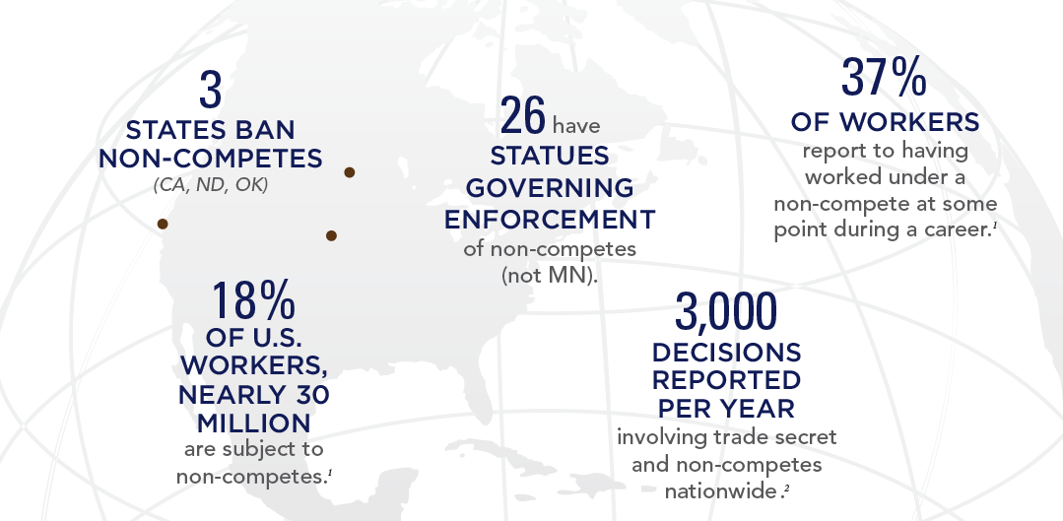
Non-Competes in the United States

Slide 4
Common Provisions in Non-Compete Agreements
Non-Compete Covenant
Non-Solicitation Covenant
Trade Secret/Confidentiality Provision
Anti-Raiding Provision
Shop Rights Provision

Slide 5
Requirements for an Enforceable Non-Compete
Independent Consideration
Protect Legitimate Business Interest
Reasonable in Scope, Duration, and Geographic Territory

Slide 6
Independent Consideration
Must confer a “real advantage” to an employee
Common Examples of Independent Consideration:
New Employment
Increased Compensation
One Time Bonus
Stock Offer
Promotion
Continued Employment is NOT Alone Sufficient

Slide 7
Legitimate Business Interest
Goodwill and Customer Relationships
Confidential Information and Trade Secrets
Specialized Training

Slide 8
Reasonable in Scope
Customer-Based or Product-Based Restrictions
Common Issues:
Preexisting customers brought by employee
Prospective customers
Cold call customers
Limited or no direct customer contact

Slide 9
Reasonable in Duration
Two Standards:
Length of time necessary so that employer’s customers no longer identify former employee as working for employer; or
Length of time necessary for employer to hire and train replacement employee
Two Years – Typically Reasonable in Minnesota

Slide 10
Reasonable in Geographic Territory
Fact Specific Depending on Business and Customers
Best Practice: Limit geographic scope to area where employee will actually work.
Using Non-Solicitation Provisions Instead of Geographic Restrictions

Slide 11
Other Key Non-Compete Provisions
Attorneys’ Fees and Expenses
TRO/Injunction & Irreparable Harm
Choice of Law and Venue
Tolling of Non-Compete Period

Slide 12
Other Key Non-Compete Provisions
Confidentiality Provision
Inventions
Return of Property
Defend Trade Secrets Act Disclosure
Notice to Prospective Employers/Notice to Company
Assignability

Slide 13
How do you enforce a non-compete?

Slide 14
Handling suspicions about employees
Cease and Desist Communications
Preserving Evidence / Forensic Examinations
Temporary Restraining Orders
Litigation
Damages

Slide 15
Hiring Someone with a Non-Compete

Slide 16
Hiring Someone with a Non-Compete
Is the applicant subject to a restrictive covenant?
Is the restrictive covenant valid?
What can the candidate still do for me?
How can I carefully draft the job offer?
Do I need to respond to this “cease and desist” letter?
I have been sued! Can I defend this?

Slide 17
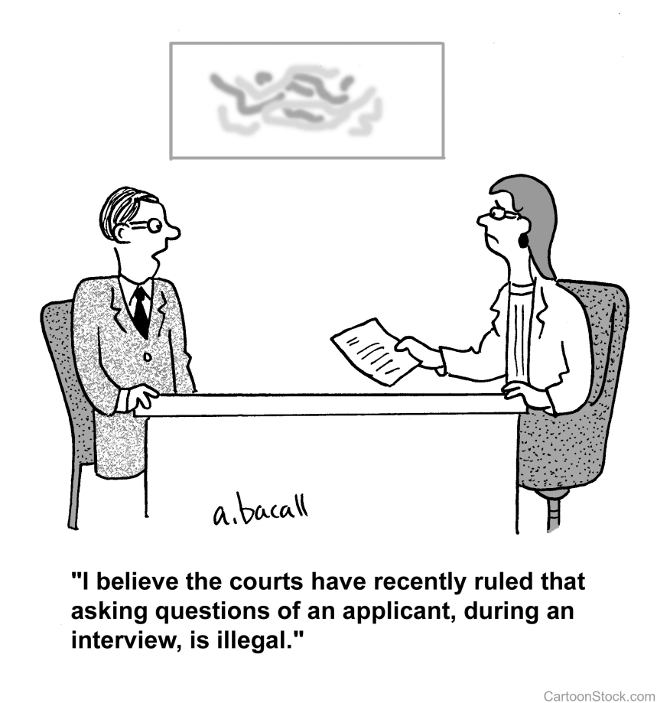
Is the Applicant Subject to Restrictive Covenant?
Make this inquiry early in the process
Often found in an employment agreement, but not always:
Stock option agreement
Deferred compensation agreement
Confidentiality agreement
Inventions agreement
If no, recite this in the offer letter and make offer contingent on absence of restrictive covenant
If yes, obtain a copy of the restrictive covenant

Slide 18
Is the Restrictive Covenant Enforceable?
Consult with outside legal counsel
Reasonable reliance on outside counsel is a defense to tortious interference claim
Choice of Law Provision
Consideration
Executed at the outset of prior employment
Non-illusory benefit conferred in connection with mid-employment restrictive covenant
Vague or Unreasonable in Scope
Temporal restriction
Geographic restriction
Customer solicitation restriction (words matter)
Notes:
Sysdyne Corp. v. Rousslang

Slide 19
Can the Applicant Function within Restrictions?
Assign employee to a different account/customer during restricted period
Assign employee to a different territory during restricted period
Assign employee to a different division during restricted period
Avoid “inevitable” disclosure of trade secrets
Avoid disclosure of confidential information
Notes:
For some positions/employers, this simply wont work and the employer should consider not hiring the employee.

Slide 20
Carefully Draft Employment Offer/Job Description
Disclose and enclose new restrictive covenant
Recite existence/non-existence of restrictive covenant
Precisely explain what conduct is prohibited
In all cases, explain that the employee cannot use/disclose former employer’s confidential and/or trade secret information

Slide 21
Offer Letter: Example 1
you are prohibited from, either directly or indirectly, providing products or services to any Globex Corporation customer or prospective customer with whom you worked during your last year of employment with Globex Corporation. You should understand that Acme Sales requires that you comply with these obligations. To the extent any such customer or prospective customer contacts you, you are required to inform the customer/prospective customer that you cannot work with them, either directly or indirectly.
As indicated in the attached Agreement, your offer of employment is contingent upon execution of the enclosed Employment Agreement, which contains restrictive covenants.
Re: Acme Sales Offer of Employment – Marcus Twain
Dear Mr. Twain:
Please consider this letter and the attached Employment Agreement your offer of employment from Acme Sales. As indicated in the attached Agreement, your offer of employment is contingent upon execution of the enclosed Employment Agreement, which contains restrictive covenants.
We at Acme understand that, pursuant to an agreement with your previous employer, you are prohibited from, either directly or indirectly, providing products or services to any Globex Corporation customer or prospective customer with whom you worked during your last year of employment with Globex Corporation. You should understand that Acme Sales requires that you comply with these obligations. To the extent any such customer or prospective customer contacts you, you are required to inform the customer/prospective customer that you cannot work with them, either directly or indirectly. Further, you may not utilize any confidential or trade secret information belonging to your previous employer. Any violation of your agreement with your previous employer or use of your previous employer’s confidential or trade secret information will result in discipline up to and including termination.
If you have any questions regarding these requirements of your employment with Acme Sales, please contact me.
Sincerely,
William Coyote, CEO
Further, you may not utilize any confidential or trade secret information belonging to your previous employer.

Slide 22
Offer Letter: Example 2
you are prohibited from, either directly or indirectly, providing products or services to the following customers: [Restricted Customers]. You should understand that Vehement Capital Partners requires that you comply with these obligations. To the extent any such customers contact you, you are required to inform the customer that you cannot work with them, either directly or indirectly
Re: Vehement Capital Partners Offer of Employment – Harriet Stowe
Dear Ms. Stowe:
Please consider this letter and the attached Employment Agreement your offer of employment from Vehement Capital Partners. As indicated in the attached Agreement, your offer of employment is contingent upon execution of the enclosed Employment Agreement, which contains restrictive covenants.
We at Vehement Capital Partners understand that, pursuant to an agreement with your previous employer, you are prohibited from, either directly or indirectly, providing products or services to the following customers: [Restricted Customers]. You should understand that Vehement Capital Partners requires that you comply with these obligations. To the extent any such customers contact you, you are required to inform the customer that you cannot work with them, either directly or indirectly. Further, you may not utilize any confidential or trade secret information belonging to your previous employer. Any violation of your agreement with your previous employer or use of your previous employer’s confidential or trade secret information will result in discipline up to and including termination.
If you have any questions regarding these requirements of your employment with Vehement Capital Partners, please contact me.
Sincerely,
Nancy Botwin, CEO

Slide 23
Offer Letter: Example 3
you are prohibited from, either directly or indirectly, providing products or services to any Hooli Corporation customer or prospective customer within a [##] mile radius of your prior employer’s branch located at [Former Employer Address]. You should understand that Hooli Corporation requires that you comply with these obligations. To the extent any customer or prospective customer from within the restricted territory contacts you, you are required to inform the customer/prospective customer that you cannot work with them, either directly or indirectly
Re: Hooli Corporation Offer of Employment – Jared Dunn
Dear Mr. Dunn:
Please consider this letter and the attached Employment Agreement your offer of employment from Hooli Corporation. As indicated in the attached Agreement, your offer of employment is contingent upon execution of the enclosed Employment Agreement, which contains restrictive covenants.
We at Hooli Corporation understand that, pursuant to an agreement with your previous employer, you are prohibited from, either directly or indirectly, providing products or services to any Hooli Corporation customer or prospective customer within a [##] mile radius of your prior employer’s branch located at [Former Employer Address]. You should understand that Hooli Corporation requires that you comply with these obligations. To the extent any customer or prospective customer from within the restricted territory contacts you, you are required to inform the customer/prospective customer that you cannot work with them, either directly or indirectly. Further, you may not utilize any confidential or trade secret information belonging to your previous employer. Any violation of your agreement with your previous employer or use of your previous employer’s confidential or trade secret information will result in discipline up to and including termination.
If you have any questions regarding these requirements of your employment with Hooli Corporation, please contact me.
Sincerely,
Richard Hendricks, CEO

Slide 24
Responding to a “cease and desist” letter
Evaluate the restrictive covenant
Evaluate employee’s conduct
Evaluate the employer’s potential motivation:
Bluster
Paranoia
Education
Preparing for litigation
Formulate response

Slide 25
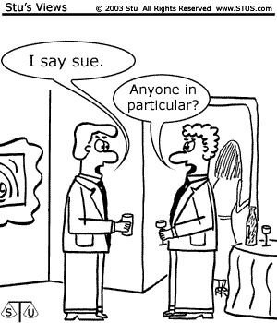
Defending Litigation Commenced by Former Employer
Even if new employer does everything right, it still may get sued
Tortious interference with contract
Tender to insurer
Preserve Emails/Documents

Slide 26
Question & Answer

